Slide 1
A Modular Model of ePortfolio Implementation
A flexible approach to starting small
Presentation by Eric Hoffman, 30 July 2013

Slide 2
Why Flexible and Small?
Trent Batson (2011):
  The Social Web and services will quickly become part of the process
  Campus life will become only richer
  Portfolio standards will not be universally recognized for years
Rapid changes in technology (especially mobile) are occurring faster than institutional capability to adapt
Small pilot implementations are lower risk, although they require longer-term visibility among administrators

Slide 3
Audience Assessment
Who Are You? Show of hands, if you feel comfortable.
New to ePortfolio implementation?
Teacher or SME tasked with starting an ePortfolio implementation, in/voluntarily?
Considering altering your current implementation?
Administrator or other interested in the modular model?
Others?
Notes:
I will present this information, and conclude with a demonstration of redacted ePortfolios from students who granted me written permission to demonstrate their ePortfolios. I remember how frustrated I was, to not be able to see representative ePortfolios, when I first started out.
The presentations here are almost all only 25 minutes, little time for interactivity.

Slide 4
Introduction to ePortfolio Components
From smallest to largest:
Artifact: a text box, image, blog entry, link to a file, link to a video, or any other chunk of content
Page: a Web page that contains an organized group of artifacts
Collection: an organized linked group of pages, linked to each other by a consistent menu
Notes:
I presume the audience for this session is mostly composed of people relatively new to ePortfolios. If you already know this stuff, please bear with me.

Slide 5
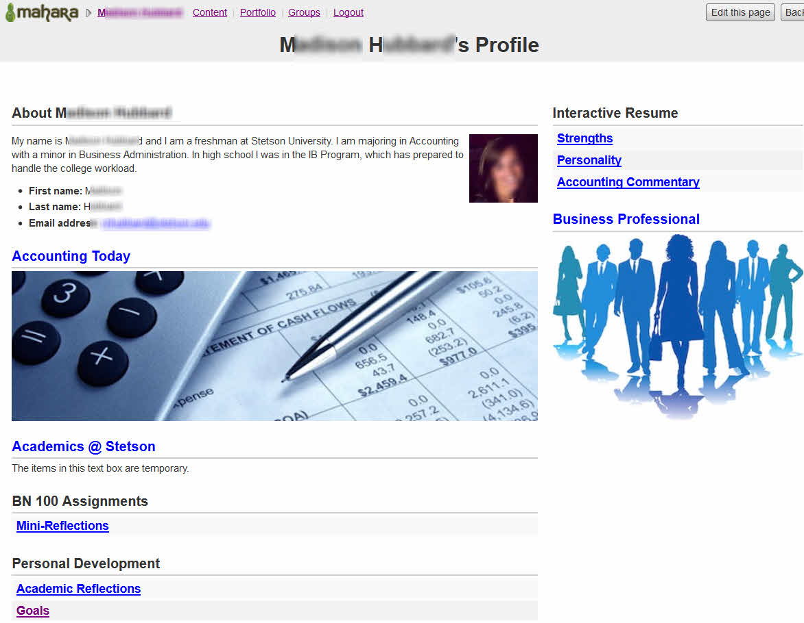
Example ePortfolio
Notes:
This example shows the “profile” page of a student using the Mahara open source ePortfolio system, in use at the Stetson University School of Business Administration.
Your system is probably different to some extent, but the results should be generalizablle.

Slide 6
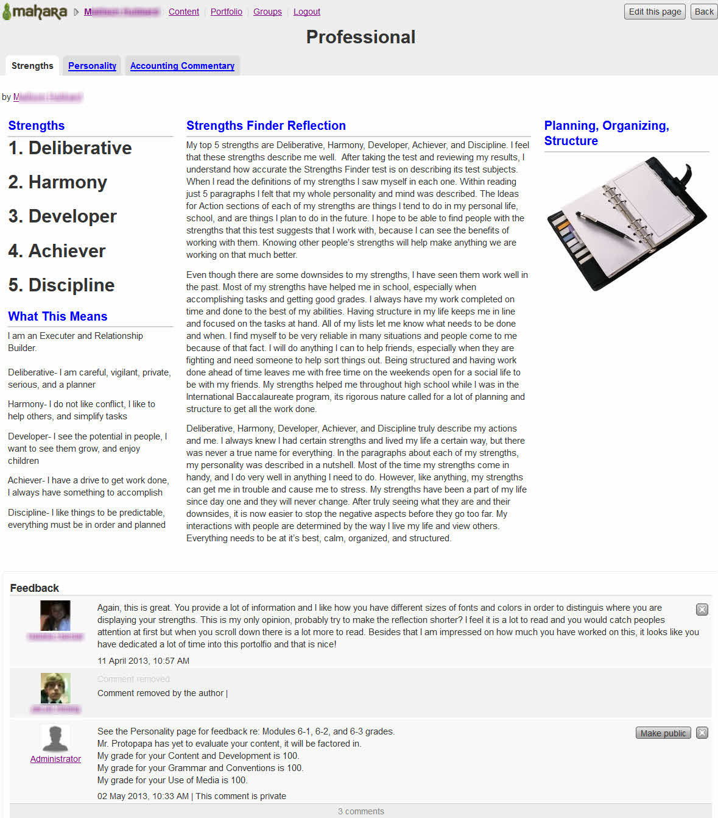
Artifacts

Slide 7
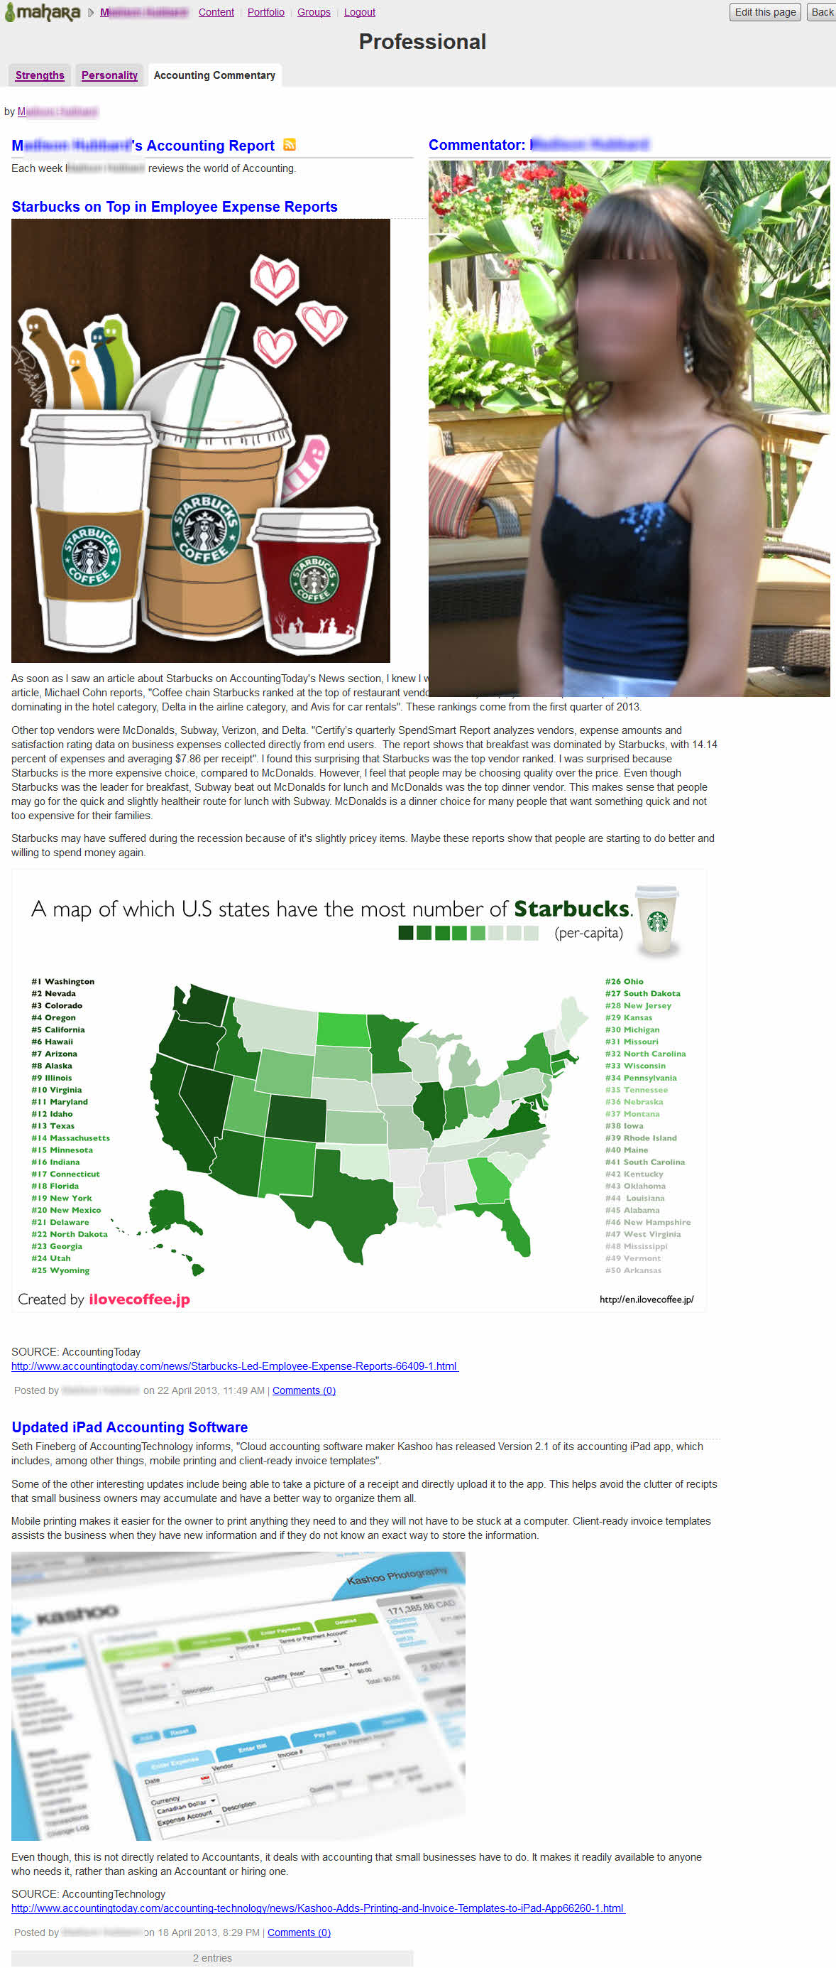
Page
Notes:
All artifacts reside on a page – in the form of a Web page, in fact. What makes them different is the context. The main difference is that the eP page fits within a formal system ef an eP.

Slide 8
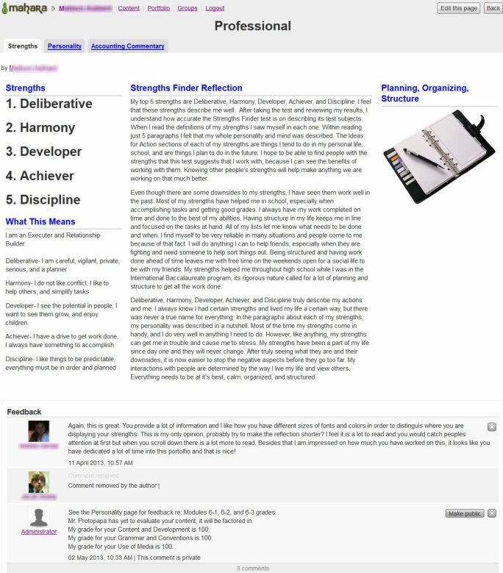
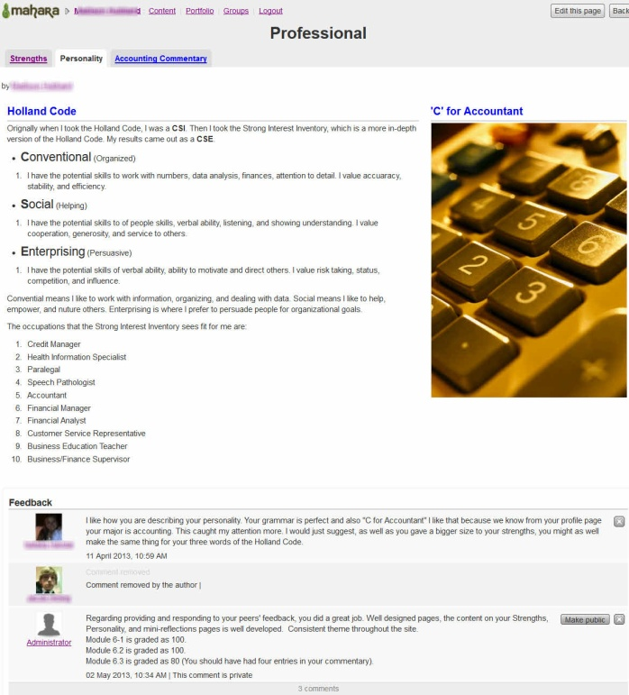
Collection
menu

Slide 9
Structure
Collection
Page 1
Artifact 1
Artifact 2
Page 2
Artifact 4
Artifact 3
Artifact 5
Page 3
Artifact 6
Notes:
This slide shows the hierarchy of a hypothetical collection. Students will have multiple collections, to meet the needs of their audiences.

Slide 10
Collection
menu

Slide 11
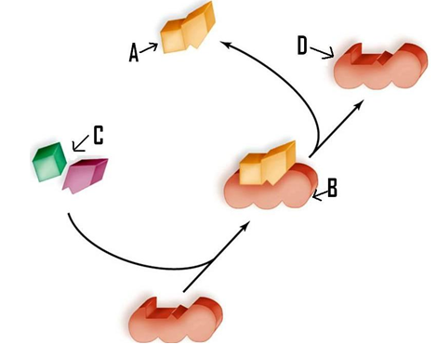
The Enzyme as an ePortfolio Analog
Polished eP collection
eP in development
Artifacts (disparate content)
ePortfolio infrastructure
Artifact: a text box, image, blog entry,
link to a file, link to a video, or any other
chunk of content
Page: a Web page that contains an organized group of artifacts
Collection: an organized linked group of pages, linked to each other by a consistent menu
“Enzymes” - Some rights reserved by SweetChickaD, flickr.com
Notes:
The desired end result is a polished eP collection (A), but it needs to be developed in the context of the eP (B). The rough artifacts (C) are required to fit the constraints of the requirements of the ePortfolio infrastructure (D).
When designed in this way, the artifacts fit with each other I a polished, cohesive whole collection, fitting within the framework of the infrastructure. One think I like about the enzyme analogy, is that the artifacts just need to fit the eP infrastucture on one side, they can otherwise be as individualized as needed. And just like real enzymes, the
Artifacts generally are multi-faceted.

Slide 12
The Modular Model Concept: Collections
Students have ePortfolios organized into multiple COLLECTIONS:
Professional
Personal Development
Each class or major co-curricular activity
Each COLLECTION can be viewed by corresponding audience:
General public
Advisors
Instructor (and instruction team), classmates
Notes:
The Professional collection is designed to serve as the student’s showcase to the world, evidence of high-level accomplishments.
The Personal Development collection is used by the student and advisors throughout the academic career, to confirm progress toward the educational goals, and address any problems within a closed, trusted environment. Permissions to view are controlled by the student.
Each class will have its own collection, and be viewable by the instructor and his/her support team), as well as classmates. Major co-curricular activities or organizations will be similarly structured.

Slide 13
The Modular Model Concept: Duration
Professional: Permanent
Personal Development: Duration of enrollment
Individual Class: Semester-long, then archived
Co-Curricular Organization: Duration of enrollment
Notes:
Any given collection can be considered “permanent,” but will generallyu only bne active and growing, as long as it makes sense. For example, when a class is finished, students won’t be contributing to it. However, they will be contributing to their professional portfolios, throughout their academic careers, and possibly well into their professional careers. The Alumni and Development offices like this, as it creates ties with the school after they graduate, at the cost of a little cheap storage, and a miniscule amount of bandwidth.

Slide 14
The Modular Model: Assessment
Professional: Office of Career Development manual assessment
Personal Development: Advisor manual assessment each semester
Individual Class: Instructor and peer assessment according to rubrics – database “hooks” correspond with competencies and/or curriculum mapping
Co-Curricular Organization: Advisor manual assessment each semester, or at conclusion of events
Notes:
This illustrates the people in a given institution who might assess the given collections. Some assessments might be more formal than others, and each assessment must match the institution’s strategy.

Slide 15
The Modular Model Concept: Example
Student:
Jean Aucoin
(automatic eP)
Class:
ART112
No eP
Class:
ENG 101
eP active
Class:
BN 100
eP active
Class:
PSY201
No eP
Co-Curr:
Art Atalier
eP active
Professional
Personal
Development
ENG 101
BN 100
Art Atalier
Collections
Notes:
Not all classes will use eP. In fact, most will not, at least not in the beginning.Co-curricular entities are a great potential users of ePortfolios, and should be considered as part of the assessment process.

Slide 16
The Modular Model Concept: Copy Artifacts Into Collections
Still life
painting
Internship
plan
Art Atalier
Professional
Personal
Development
Animation
Biography
Essay on Marketing
ENG 101
BN 100
Collections
Notes:
Students may be directed, requested, or volunteer to copy the best of their work into theoir professional collection. Ultimately, the eP belongs to them.

Slide 17
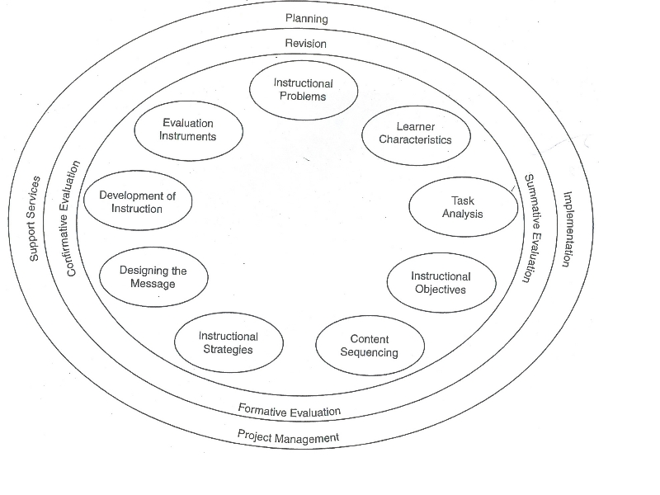
Genesis of the Modular Model
Retrieved from http://arcmit01.uncw.edu/erg1602/Glossary.html
Notes:
In the great tradition of my favorite instructional and theoretical models, cyclical information flows in a clockwise fashion. Here is the Morrison, Ross, and Kemp model of instructional Design.

Slide 18
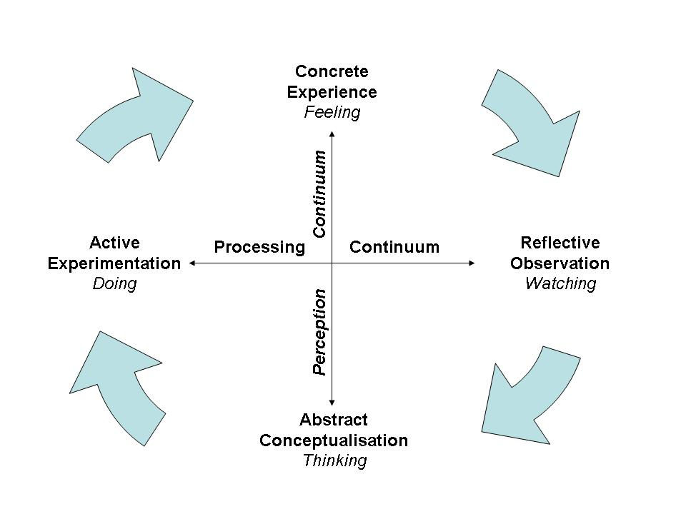
Genesis of the Modular Model
Retrieved from http://www.nwlink.com/hrd/styles/kolb.html
Notes:
Important to the concept of co-curricular learning, and enabled by eP, Kolb’s Experiential Learning model is presented here.

Slide 19
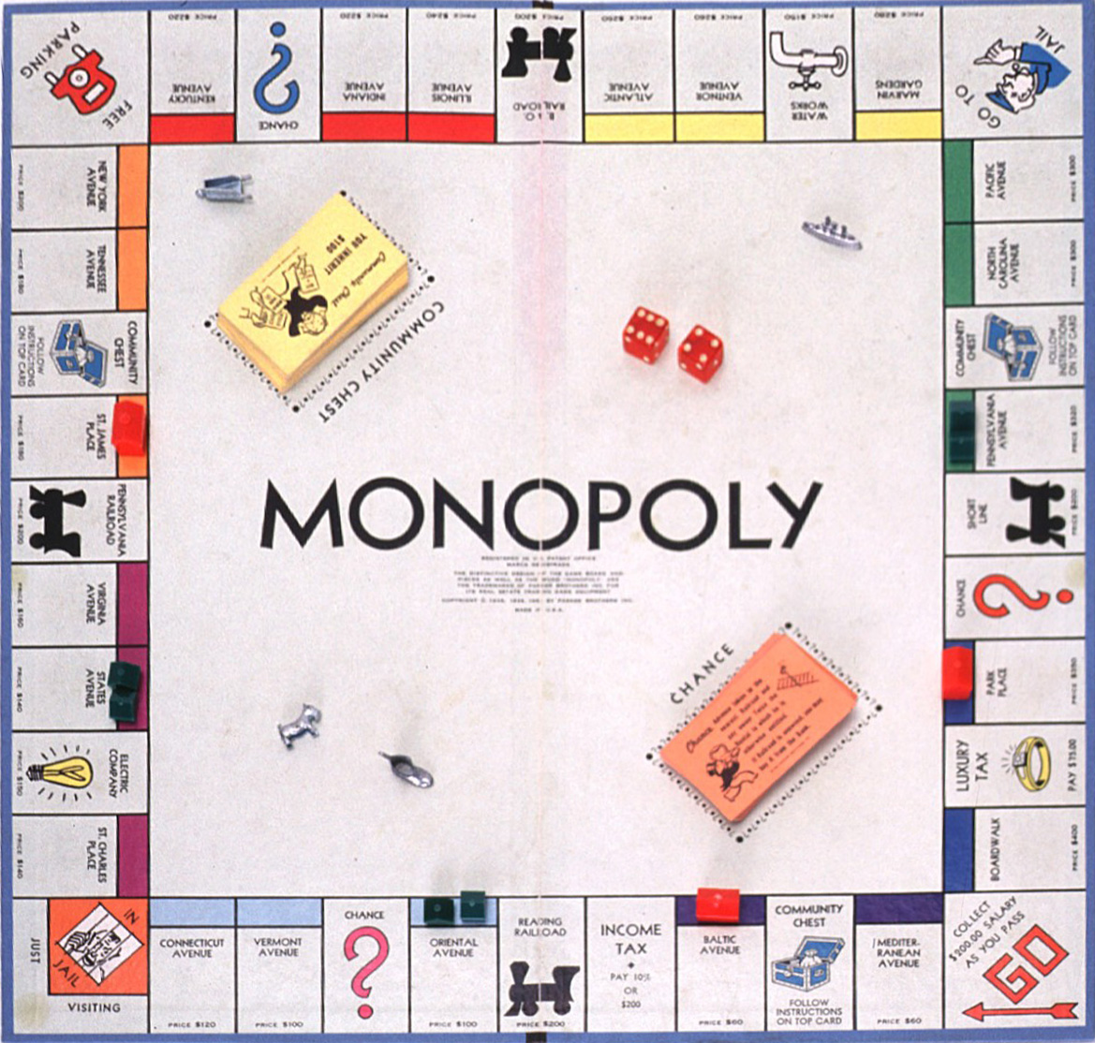
Genesis of the Modular Model
Retrieved from http://midastouch.goldgenie.com/tag/gold-monopoly-set/
Notes:
And perhaps the greatest influence, is the game of Monopoly.

Slide 20
Modular Model
Student-Centric Core
I.I.
serious interaction
I.I.
STUDENT
fun interaction
polish & assess
I.I.
mechanics
I.I.
I.I.=Instructor Intervention
Notes:
While it might seem a bit trite, it is an easily understandable framework, using a mnemonic familiar to most stakeholders.

Slide 21
Modular Model
Student-Centric Core Details
I.I.
ac ac ac ac ac ac
I.I.
STUDENT
Challenging group construction, serious interaction, peer assessment and feedback
Assignments & community building - fun interaction
Polish, copy to professional collection, final assessment & archive
ac ac ac ac ac ac
ac ac ac ac ac ac
ac = student activities
Mechanics - the computer
science of eP
I.I.
I.I.
ac ac ac ac ac ac

Slide 22
Modular Model
Instructor Intervention Details
Assess group progress & cohesion, intervene as needed
I.I.
I.I.
Assess group activities, reinforce results
STUDENT
Assess final eP, results to institution, create next course or entity
Assess construction, intervene as needed
I.I.
I.I.

Slide 23
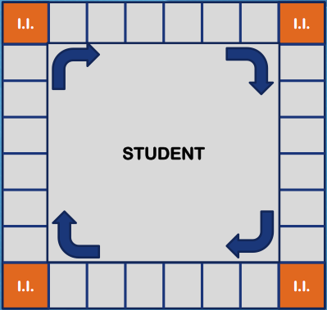
The Larger Framework of the Modular Model
Societal, customer, and institutional foci
I.R.O.
Accreditation, etc.
Marketing
Showcasing, etc.
results
???
Other uses

Slide 24
ePortfolios – Who cares?
Stakeholders:
Society – “the public,” governments, agencies, foundations
Customers – students, hiring businesses
Institution – faculty, staff, administration
Notes:
Helen Chen and Tracy Penny-Light state that identification of stakeholders, and identifying their needs can help win support for ePortfolios (Chen & Penny-Light, 2010, p. 10).
Knight, Hakel, and Gromko (2008) provide a lot of evidence that “Members of the public, employers, and legislators are concerned with the perceived lack of attention that faculty give to undergraduate learning” (p. 1).
Yet, after Gail Ring was charged with the implementation of institution-wide ePortfolios at Clemson, she noted that key faculty and staff were disinterested, despite the institutional mandate (Schaffhauser, 2010, p. 33).

Slide 25
Alignment of Stakeholders and Orientation
Stakeholders
Society – “the public,” governments, agencies, foundations (mega)
Customers – students, hiring businesses (macro)
Institution – faculty, staff, administration (micro)
Orientation (ePortfolio types):
Assessment – accreditation, evidence of (program) success and worthiness
Career/Showcase – evidence beyond diplomas/transcripts
Learning Development – evidence of engagement, experiential learning
Notes:
Using Roger Kaufman’s (2001) Organizational Elements Model, we can try to align the stakeholders with they typical orientation of ePortfolios. Unless an institution understands the potential of all types of ePortfolios, and fully supports them down to the faculty/staff level, and incorporates them into its culture, success is likely to be haphazard.

Slide 26
Ideal Alignments and Prioritization
Student learning
Faculty and staff
Programmatic connections
Institutional needs & support
Stakeholders - Orientation
Society – Assessment
Customers – Career/Showcase
Institution – Learning Development
Adapted from Bass, 2012
Notes:
The ongoing “Making Connections” project led by Brett Eynon (Bass, 2011; Making Connections, 2013) prioritized the elements of successful ePortfolio implementation, with student learning as the greatest priority.
Notice that the pyramid, is contained in the lowest level of the Stakeholder/Orientation list.
This is not a problem, as long as the institution’s mission and activities support the concept that student learning is the highest priority.

Slide 27
Societal Needs and Assessment
Assessment ePortfolio as a management-oriented accountability measure – checking of results - versus use as a tool for attainment of learning
Assessment lite: reduces initiative and creativity
Possible motivations for assessment (Ewell):
  Benchmark institutional performance in the name of accountability as in K-12 education
  Provide feedback about student performance to improve curricula and pedagogy
  Determine an individual student’s mastery of learning and to provide feedback for improvement
Notes:
Societal concern about the quality of higher education probably precipitates assessment-driven ePortfolios, as a quantifiable accountability tool.
Chinese-born Education Researcher Yong Zhao asserts that in its quest for universal accountability, the U.S. education system is transforming itself from a producer of independent thinkers and entrepreneurs into a system that produces skilled workers competing with outsourced cheap labor from around the world (Pierce, 2013).
Ewell (2002) states that current assessment efforts generally have a wide but shallow scope, resulting in a waste of energy and effort. He questions the current popular motivations for institutional assessment, stating that such efforts ultimately have little positive impact on education.
The first motivation here is relatively easy for institutions, but really have little societal impact. The second and third motivations are more expensive, but result in high-impact practices, that positively affect society, customers, the institution, and its constituent members.

Slide 28
Customer Needs: Students, and Hiring Businesses
1956 - Why Johnny Can’t Read; basic number skills test; years of experience; subjective judgment based on “personality”
2013 – Innovation, critical thinking, and a broad skill set are important for taking on complex challenges in the workplace
Students: disconnect between ePortfolio benefits and results: how is this relevant?
Notes:
The AAC&U sponsored a study (Hart Research Associates, 2013), that showed strong employer interest in much higher skills that 57 years ago, including direct recognition for ePortfolios, and how they can provide evidence of these desired traits, well beyond the traditional diploma and transcript.
Although I haven’t researched it yet, my experience shows that college freshmen need a lot of reinforcement

Slide 29
Institutional Needs: Faculty, Staff, Administration
Except for early adopters, most institutional stakeholders don’t understand ePortfolios and the steps required
Incorporating co-curricular (high-impact) practices are more powerful, and easily afforded by ePortfolios; yet they are highly disruptive to traditional university hierarchies, and expensive
Notes:
Helen Chen and Tracy Penny-Light (2010) wrote a and excellent 44 page booklet on implementing ePortfolios. But getting buy-in from all the stakeholders is difficult, as understanding the implications requires a significant expenditure of the precious commodities of time and effort, just to give the concept due diligence. This might be the major initial obstacle for proper consideration of an institution-wide implementation of ePortfolios. This is also the reason why an early adopter approach might be best for an institution.
Randy Bass (2012) suggests using a designed team-based approach to teaching with technologies, especially ePortfolios. This would include instructional designers, information technologists, embedded librarians, academic advisors, all coordinated by the faculty member. Although this is expensive, economies of scale can create more a more effective learning experience with a somewhat modest cost increase. This sort of disruption may be desirable, but it might derail an ePortfolio effort, or lead to sabatoge from someone with a perceived potential loss.

Slide 30
References:
Bass, R. (2012). Disrupting Ourselves: Cherished Assumptions, New Designs, and the Problem of Learning in Higher Ed. Paper presented at the Mid-Atlantic Regional Conference, Baltimore Maryland http://www.educause.edu/MARC12/Program/GS01.
Batson, T. (2011). A Portrait of the Portfolio as a Young Movement: A Surprising Development Paper presented at the Campus Technology Virtual Conference, Virtual.
Chen, H., & Light, T. P. (2010). Electronic portfolios and student success: Effectiveness, efficiency, and learning. Washington, DC: Association of American Colleges and Universities.
Ewell, P. T. (2002). An emerging scholarship: A brief history of assessment. In T. W. Banta & Associates (Eds.), Building a scholarship of assessment (pp. 3–25). San Francisco: Jossey-Bass.
Flesch, R. (1955). Why Johnny can't read--and what you can do about it. New York, Harper [1955].
Hart Research Associates (2013). It takes more than a major: employer priorities for college learning and student success. Washington, DC: Association of American Colleges and Universities and Hart Research Associates.
Kaufman, R., Watkins, R., & Leigh, D. (2001). Useful educational results. Lancaster, PA: Proactive Publishing.
Knight, W. E., Hakel, M. D., & Gromko, M. (2006). The relationship between electronic portfolio participation and student success. Association for Institutional Research, Chicago, IL.
Kolb, D. A. (1984). Experiential learning: Experience as the source of learning and development (Vol. 1). Englewood Cliffs, NJ: Prentice-Hall.
Making Connections (2013). Making Connections (Web site). Retrieved July 15, 2013 from http://www.lagcc.cuny.edu/connections/.
Malm, F. (1955). Hiring procedures and selection standards in the San Francisco bay area. Industrial & Labor Relations Review, 8(2), 231.
Morgan, W. J., & Morgan, A. (1952). Basic Number Skills Test for Employee Selection.
Morrison, G. R., Ross, S. M., Kemp, J. E., & Kalman, H. (2010). Designing effective instruction. Wiley. com.
Pierce, D. (2013). Zhao: U.S. schools focusing on the wrong skills (Web site). Retrieved from http://www.eschoolnews.com/2013/07/24/zhao-u-s-schools-focusing-on-the-wrong-skills/

Slide 31

About the Presenter
Eric W. Hoffman, Ed.D. expected August 2014
Academic foci: ePortolios, mobile game-based learning, gerontology
Formerly Associate Director of Learning Technologies at Stetson University, currently independent contractor
http://about.me/erichoffman

Slide 32
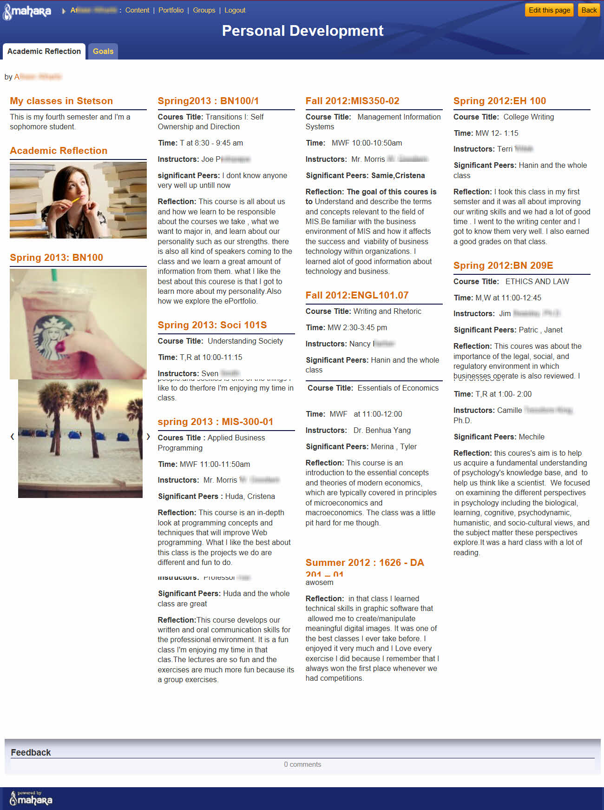
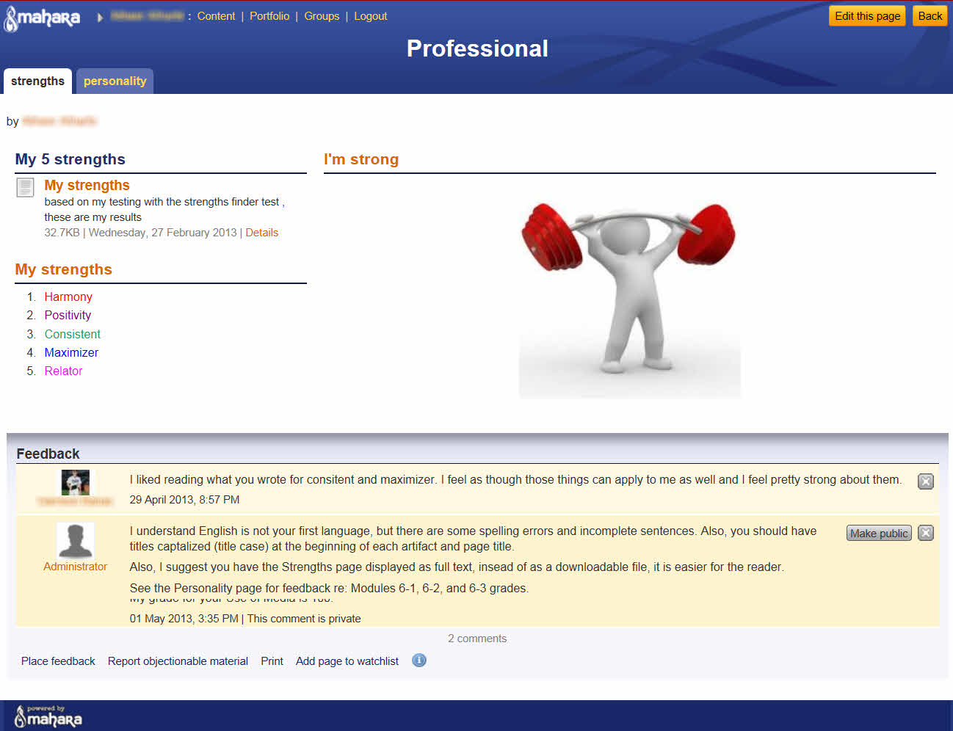
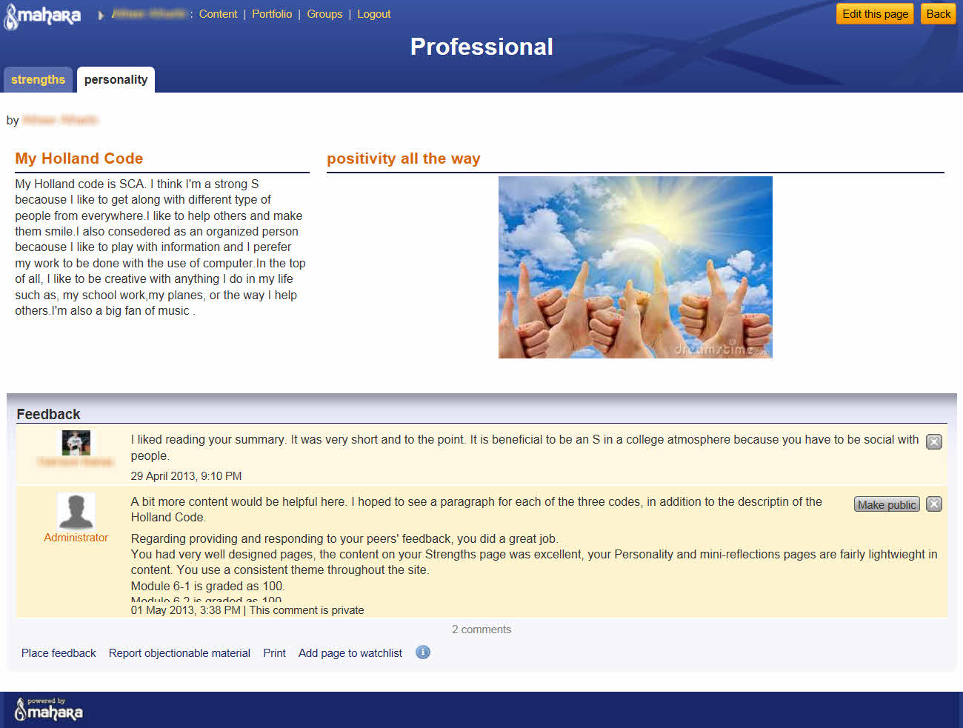

Slide 33
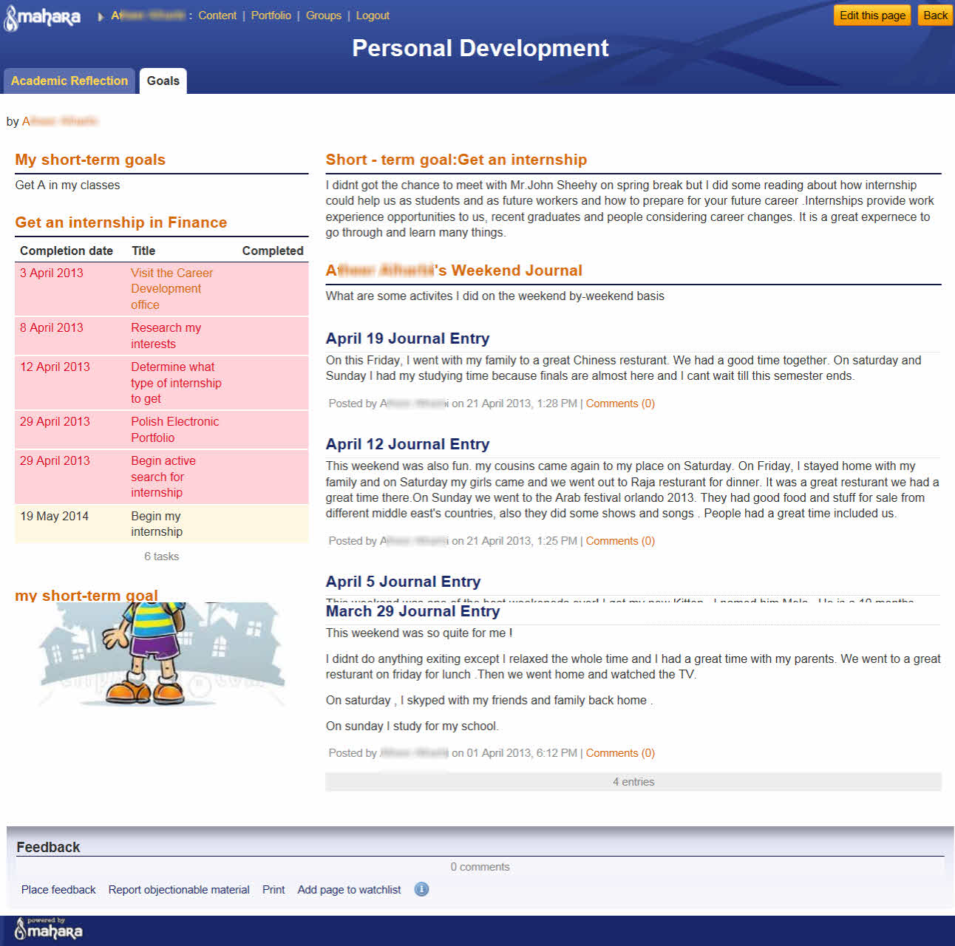
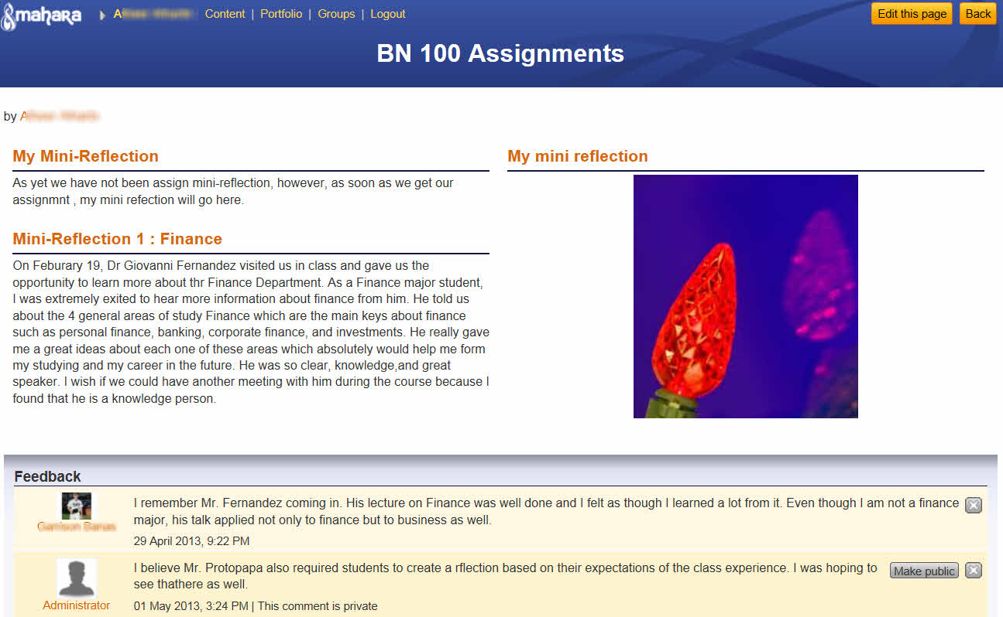

Slide 34
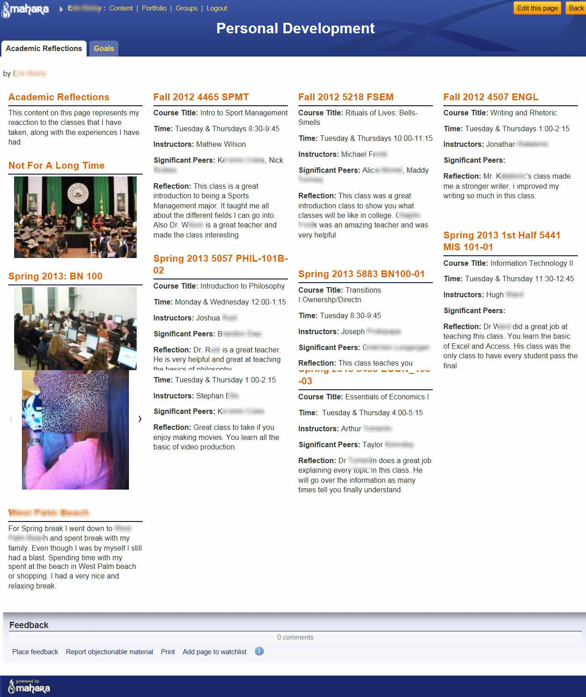
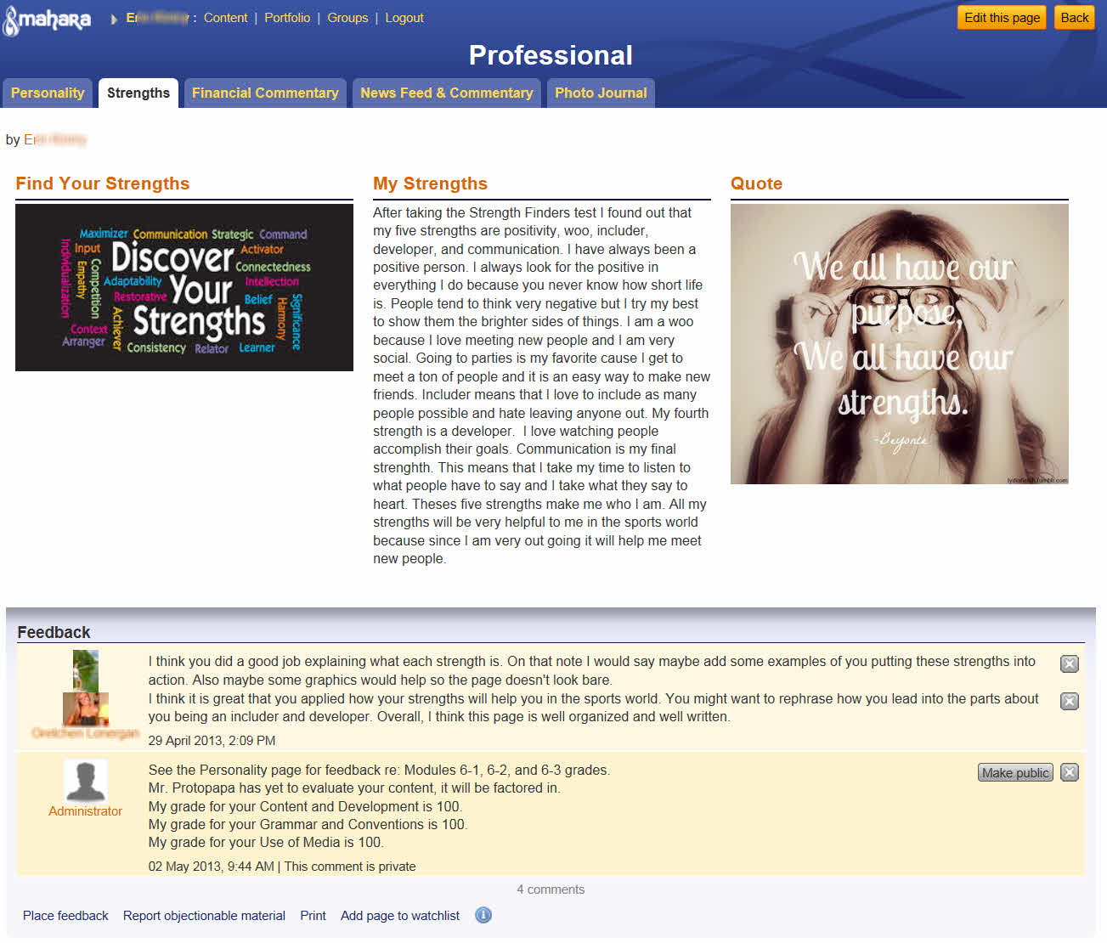

Slide 35
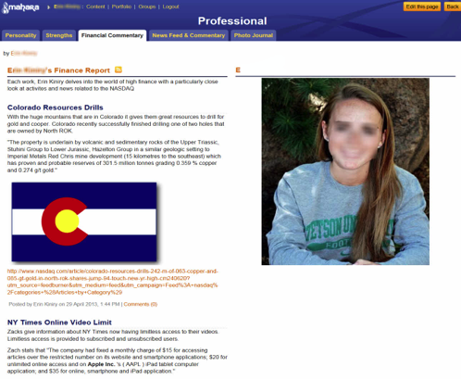

Slide 36
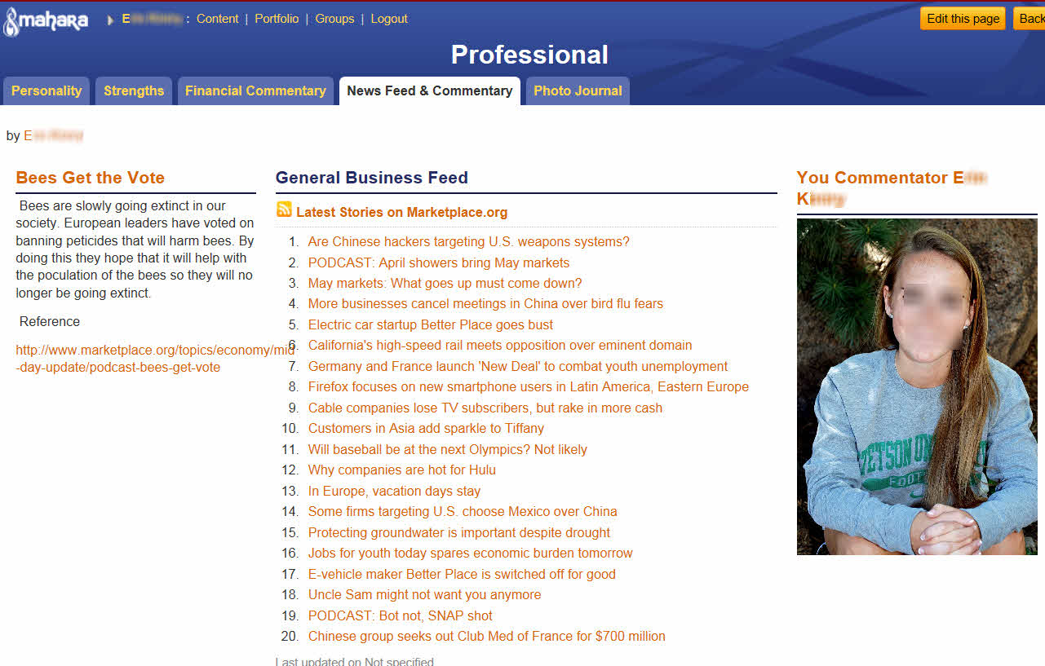

Slide 37
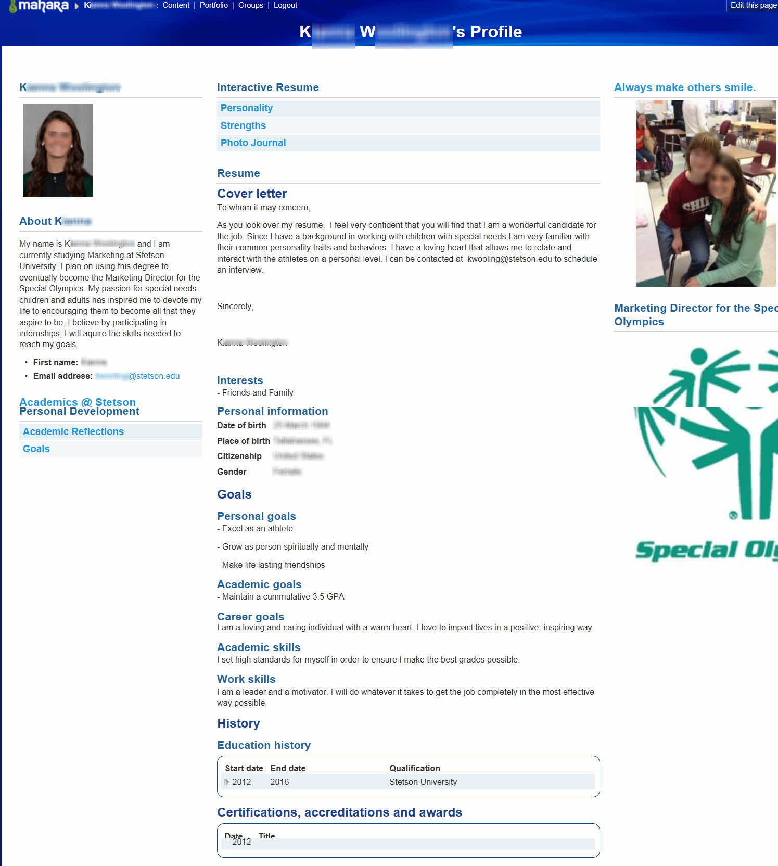

Slide 38
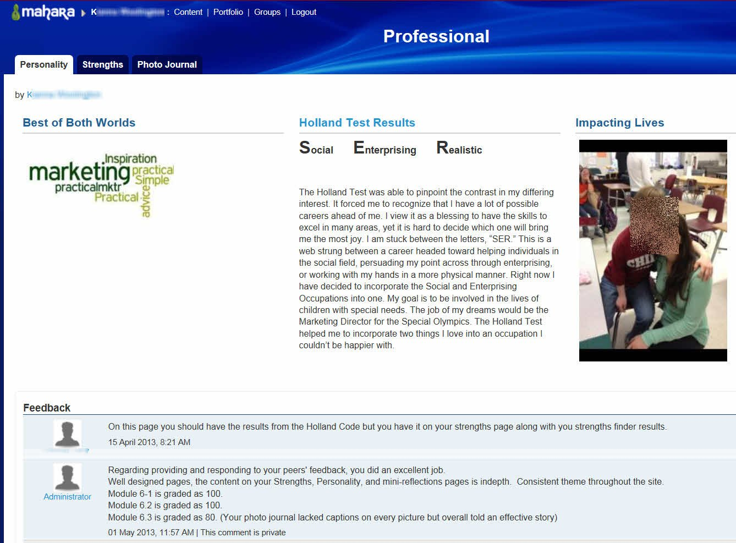

Slide 39
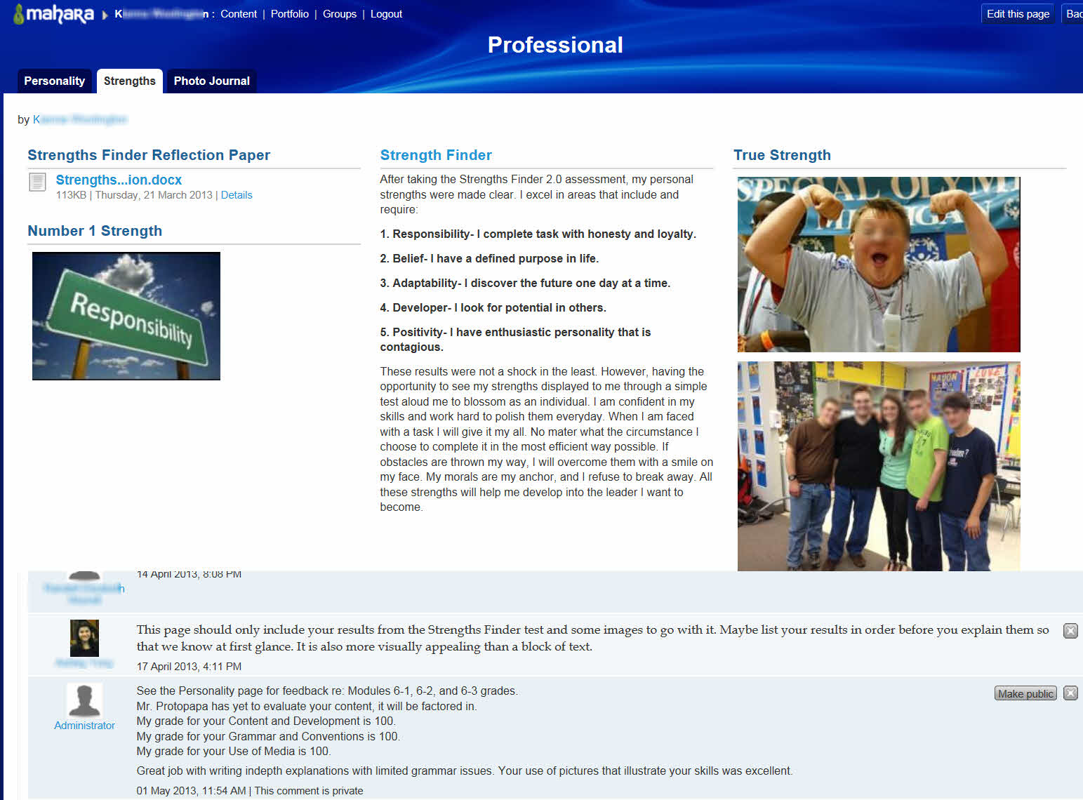

Slide 40
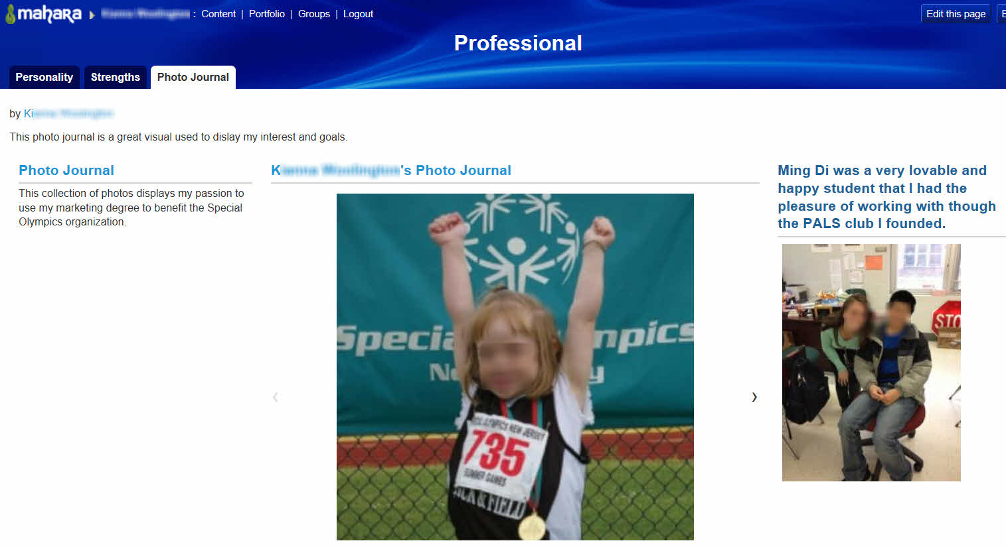

Slide 41
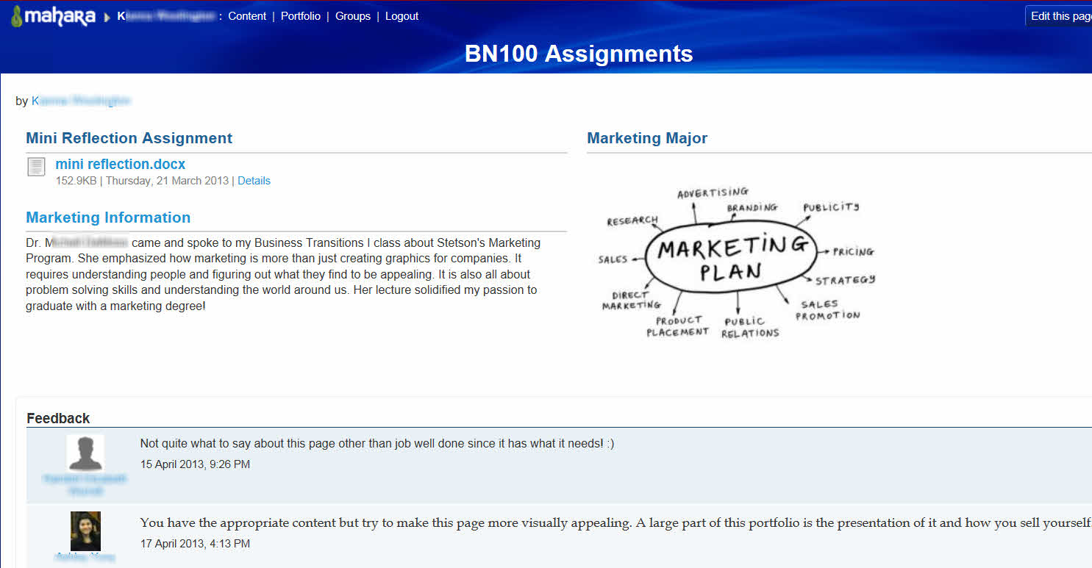

Slide 42
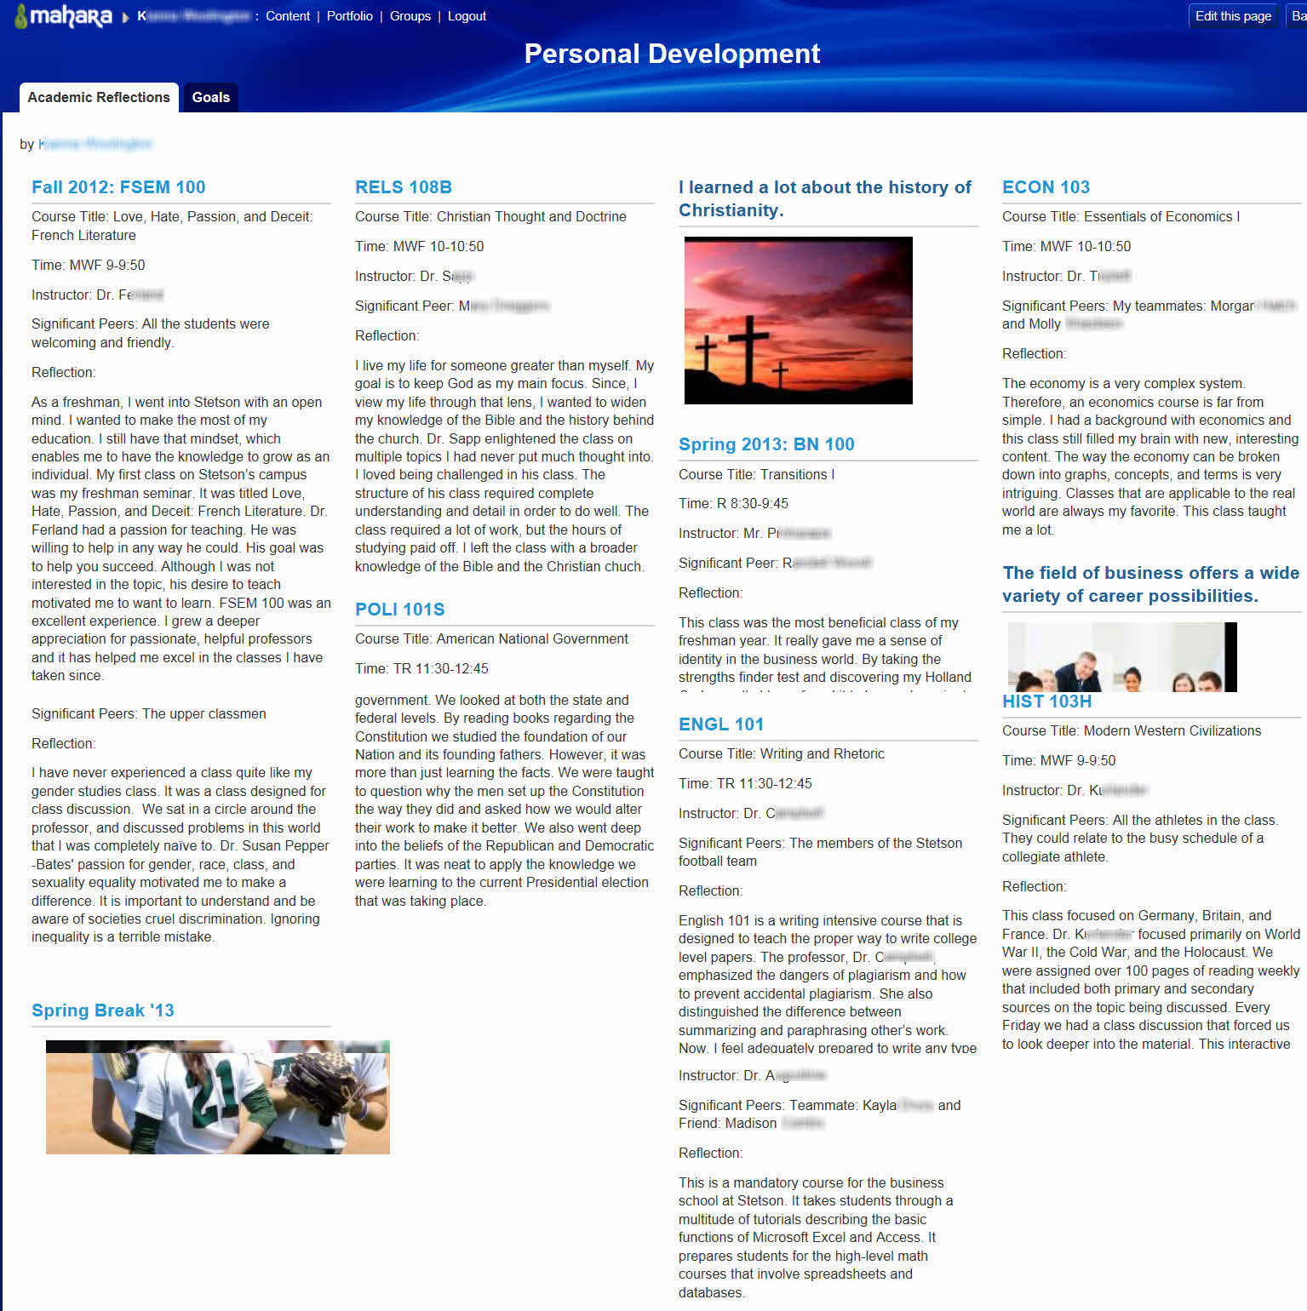

Slide 43
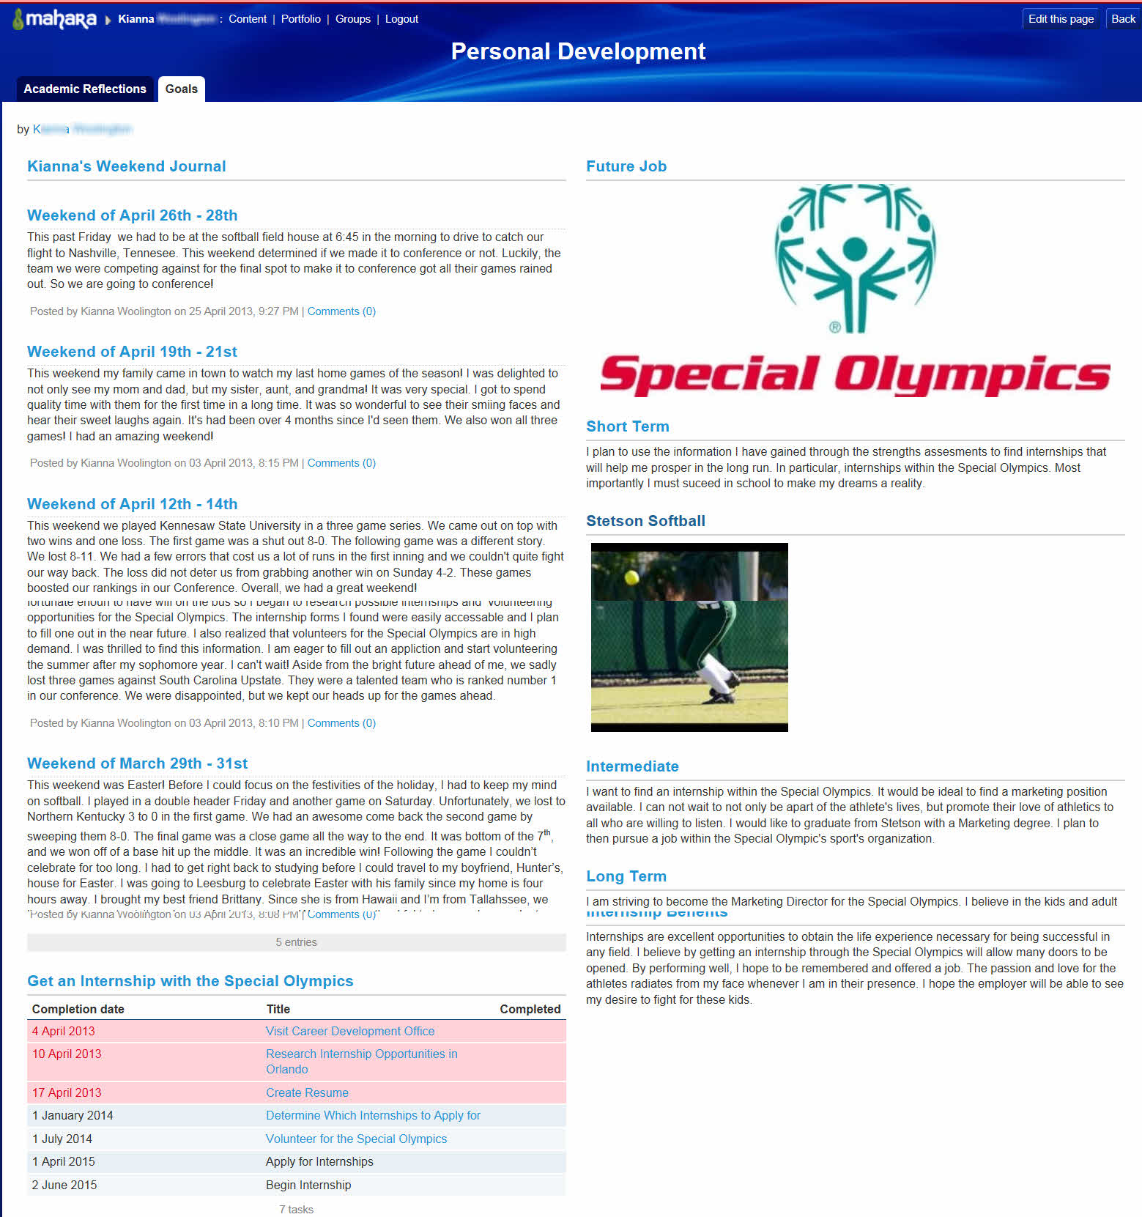

Slide 44
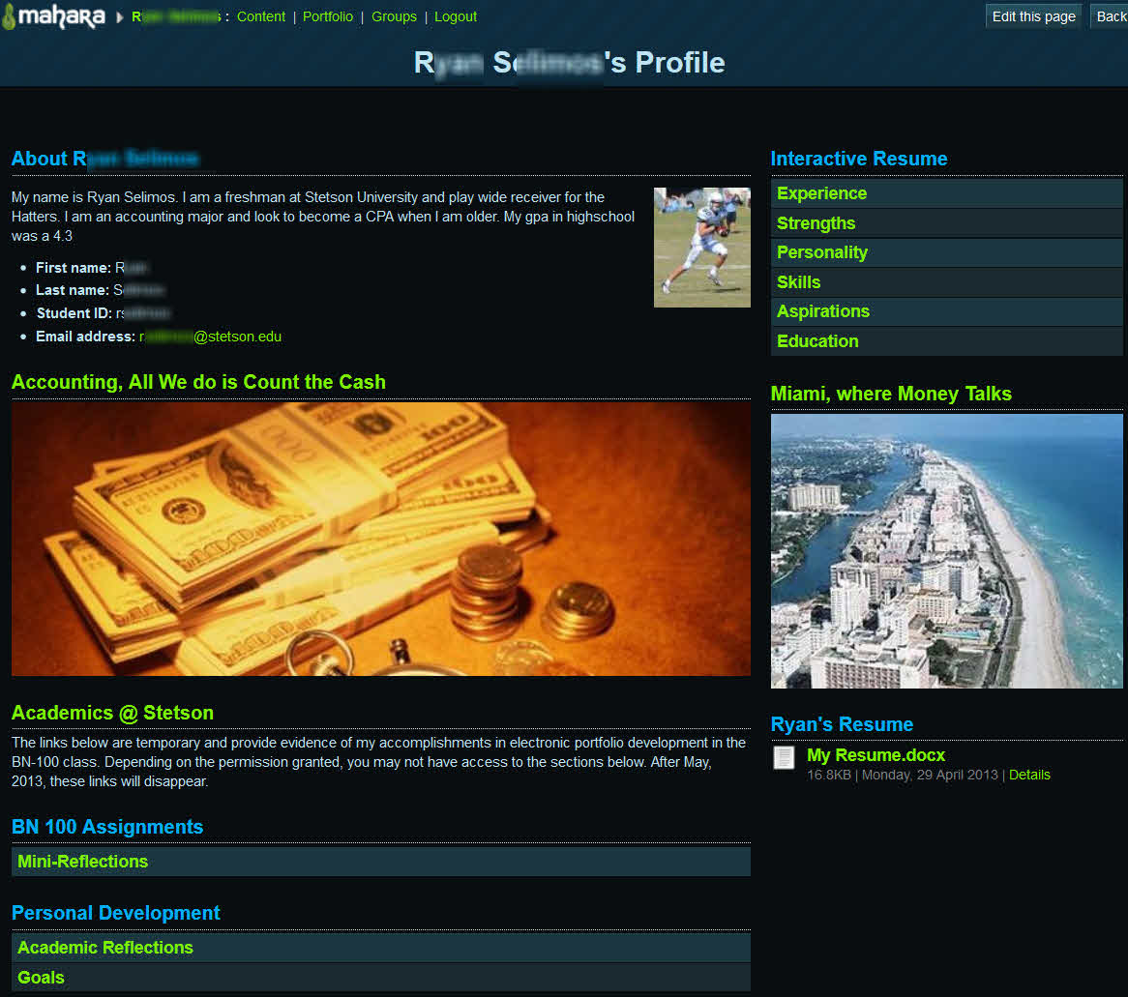

Slide 45
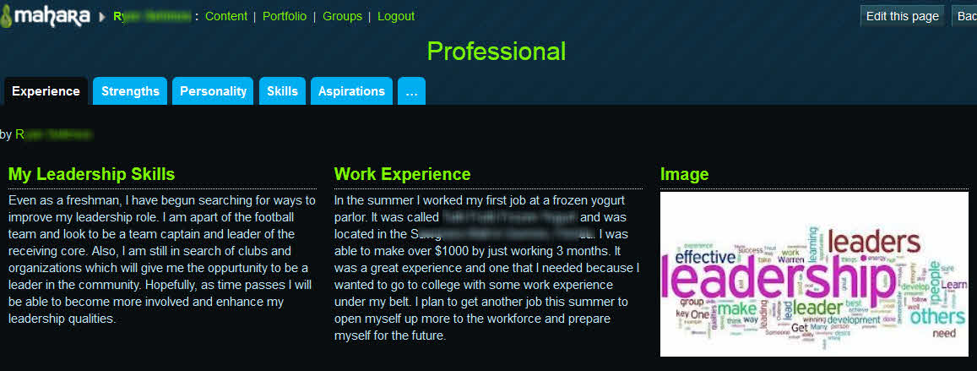

Slide 46
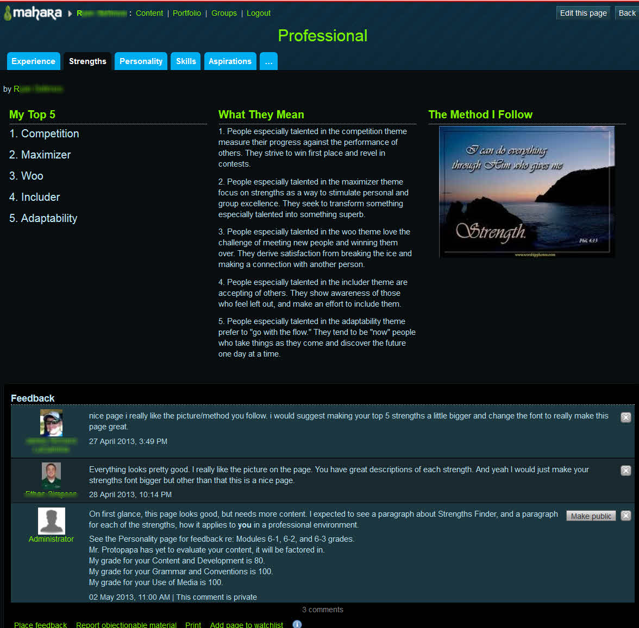

Slide 47
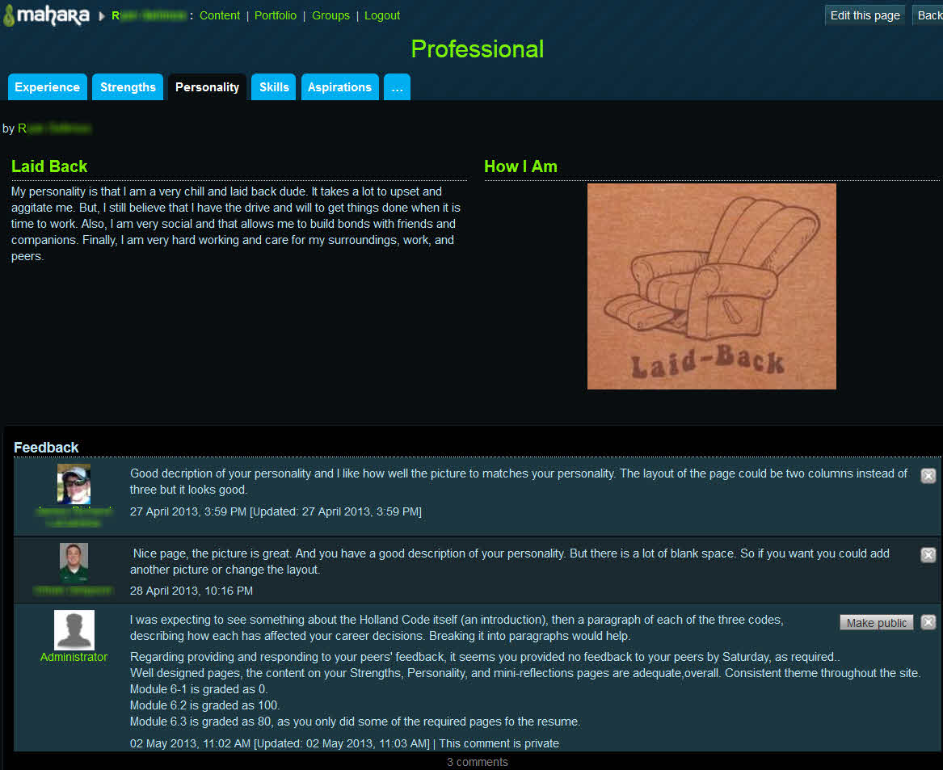

Slide 48
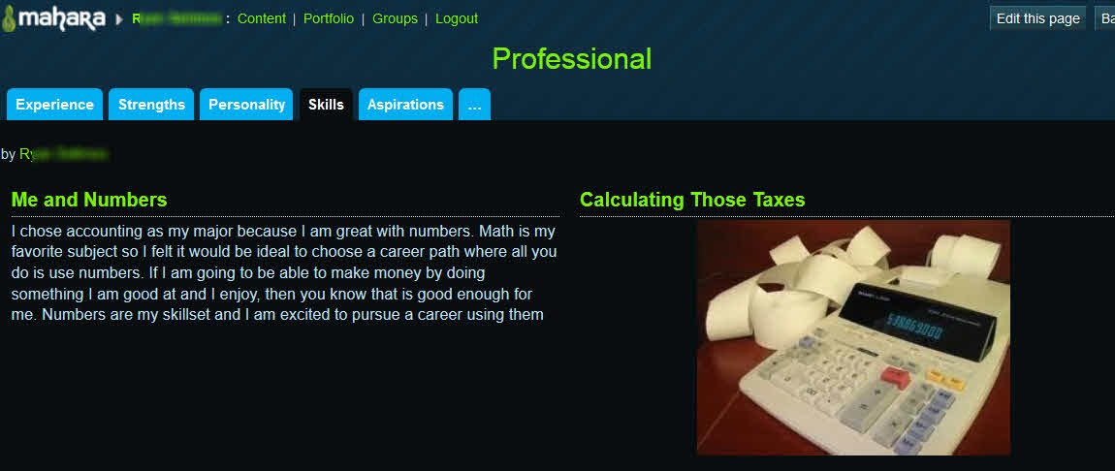

Slide 49
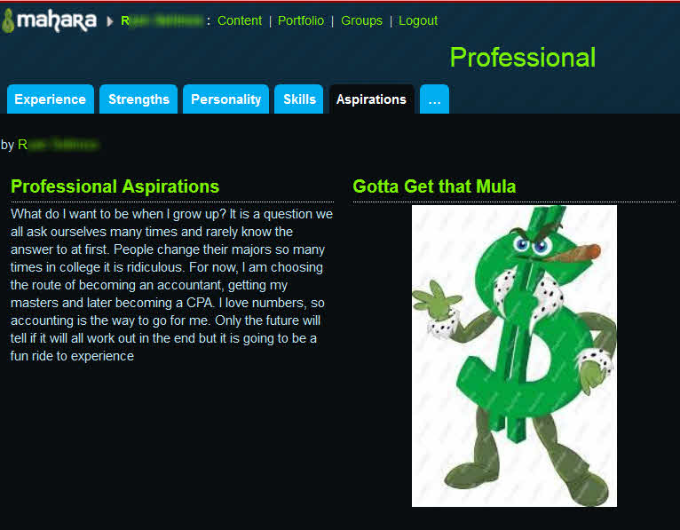

Slide 50
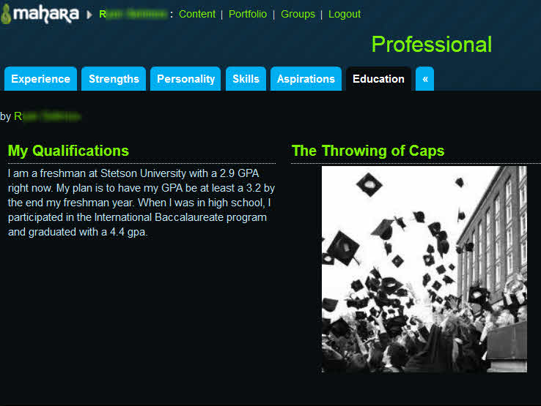

Slide 51
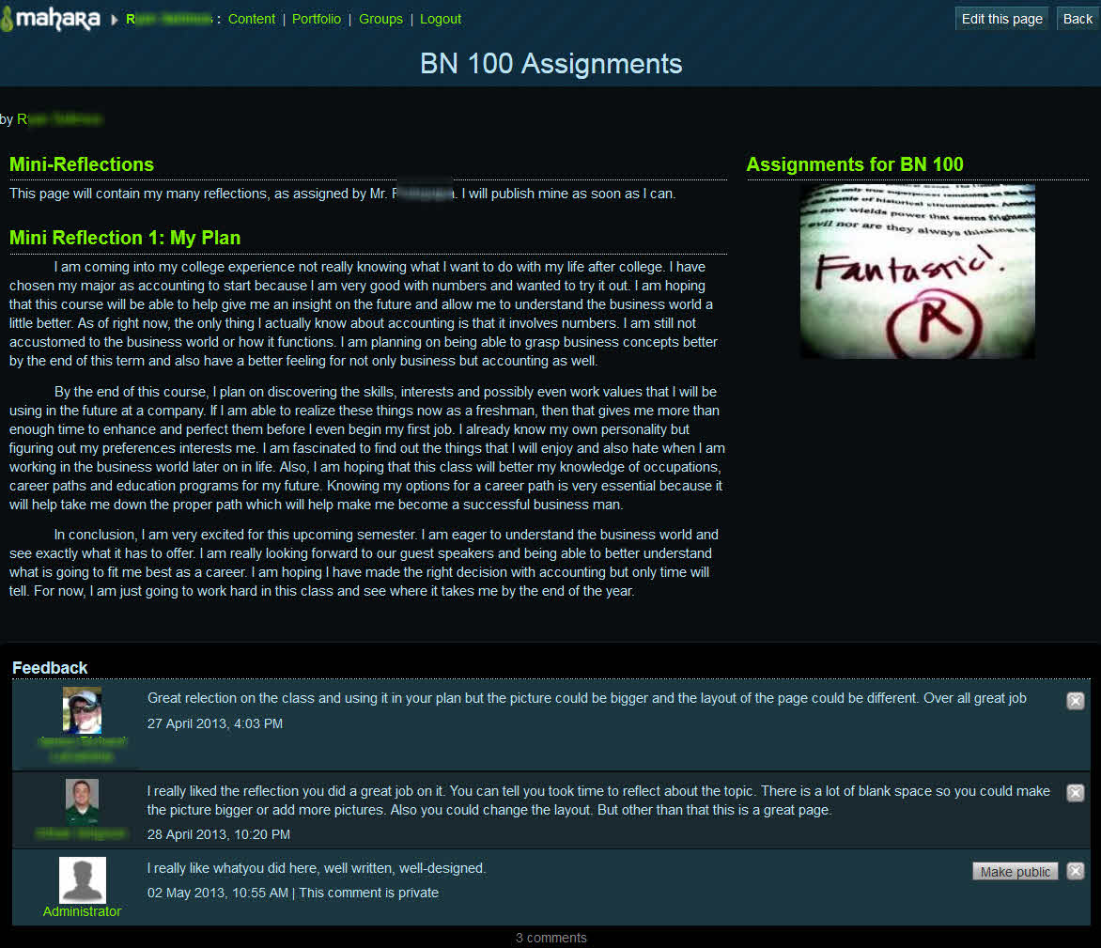

Slide 52
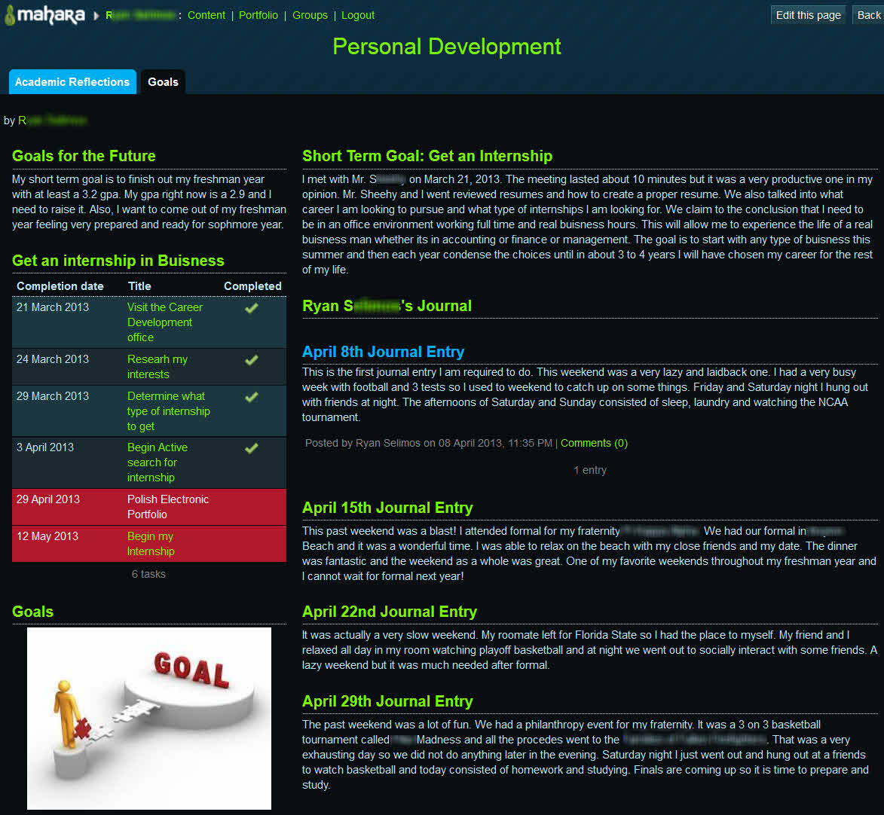

Slide 53
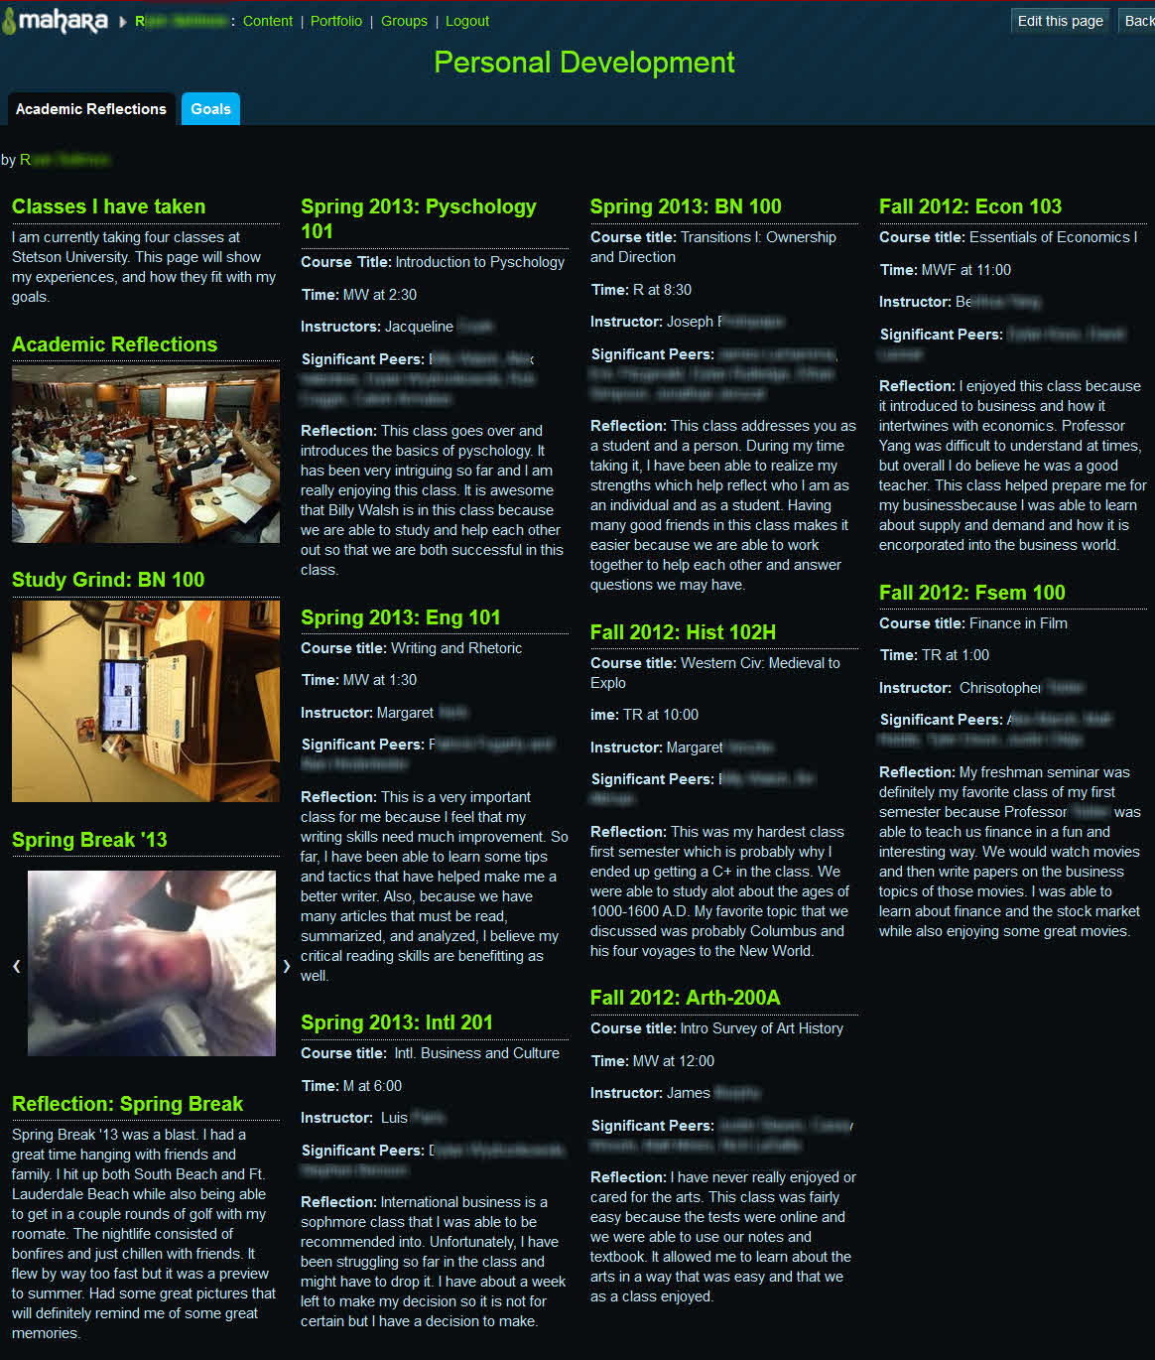

Slide 54
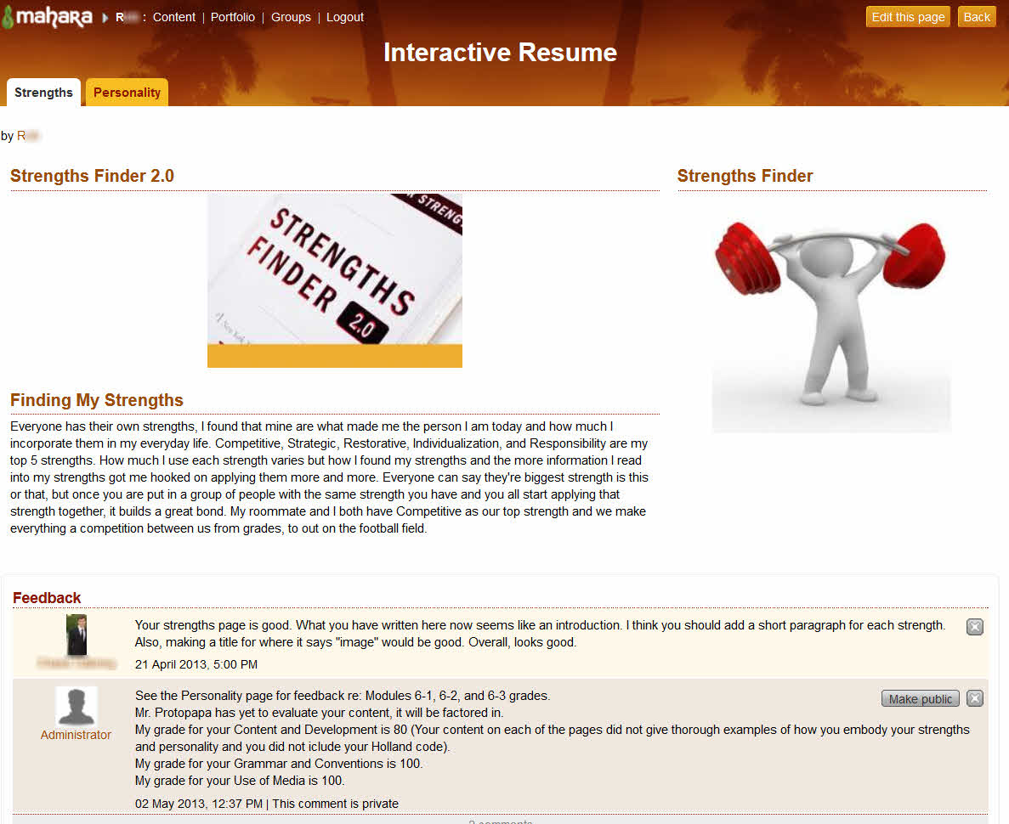

Slide 55
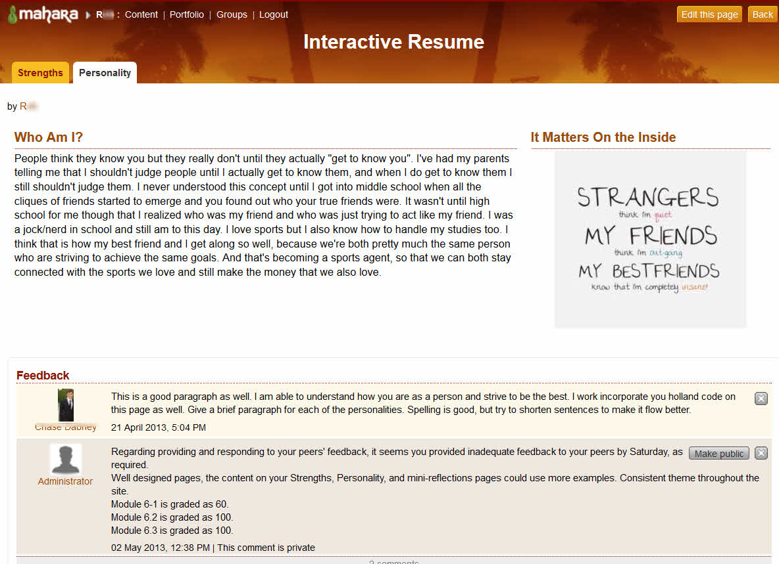

Slide 56
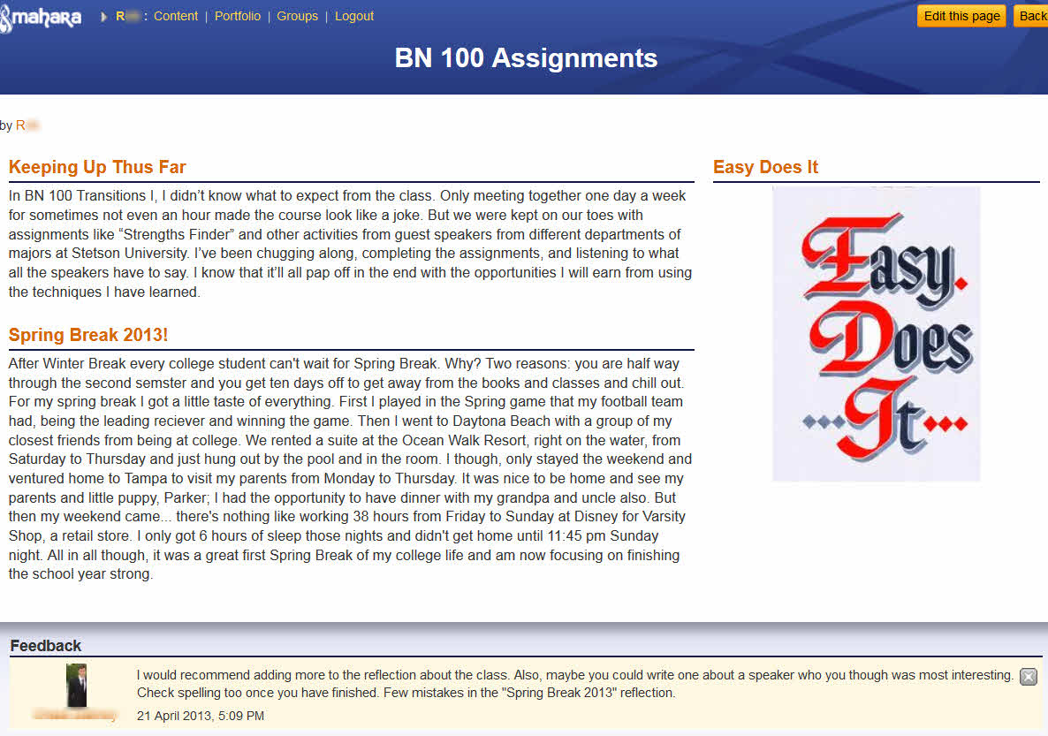

Slide 57
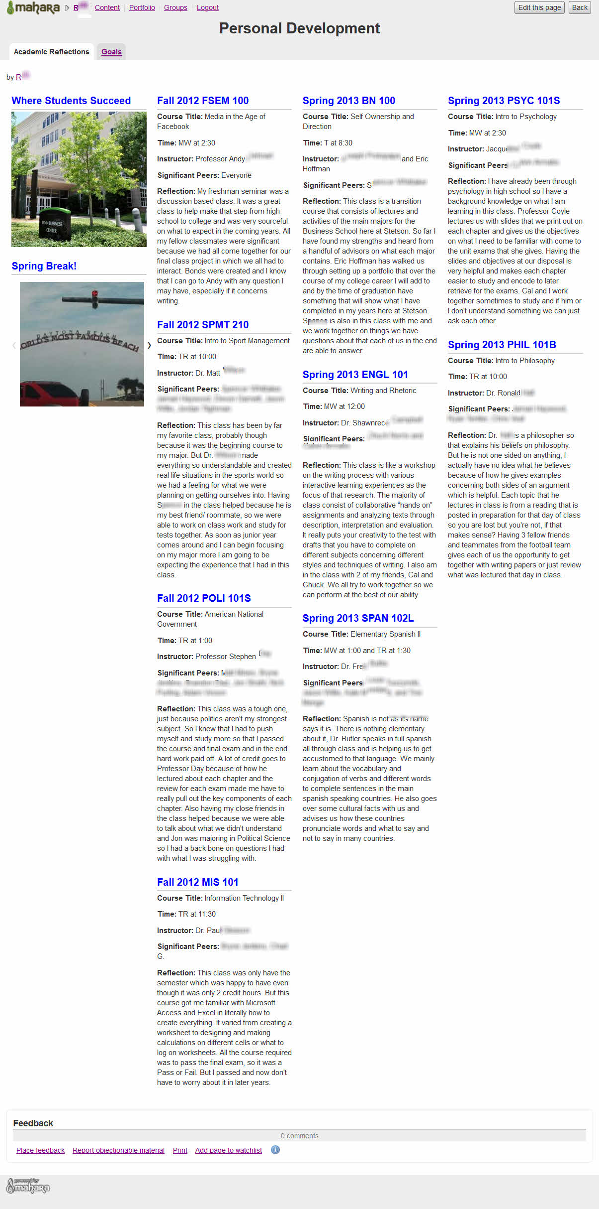

Slide 58
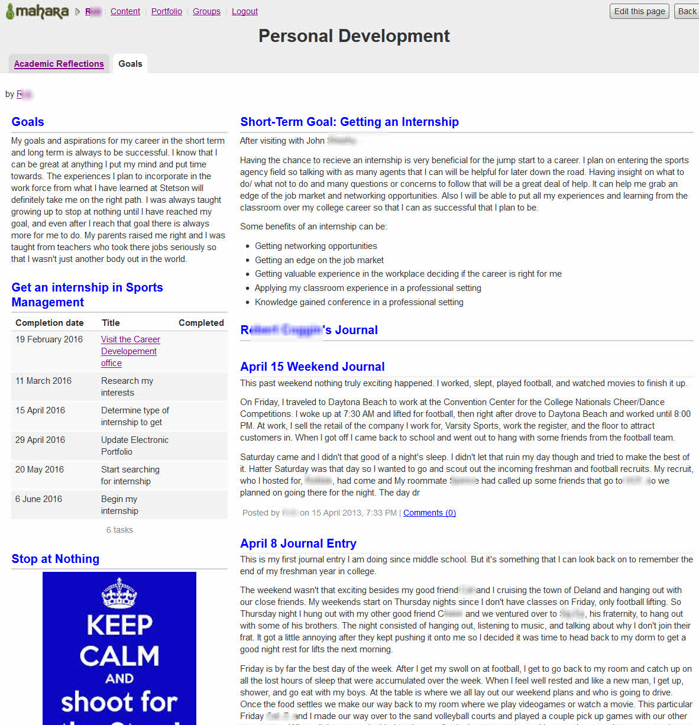

Slide 59
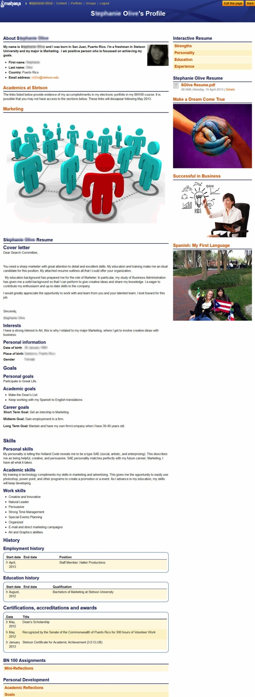

Slide 60
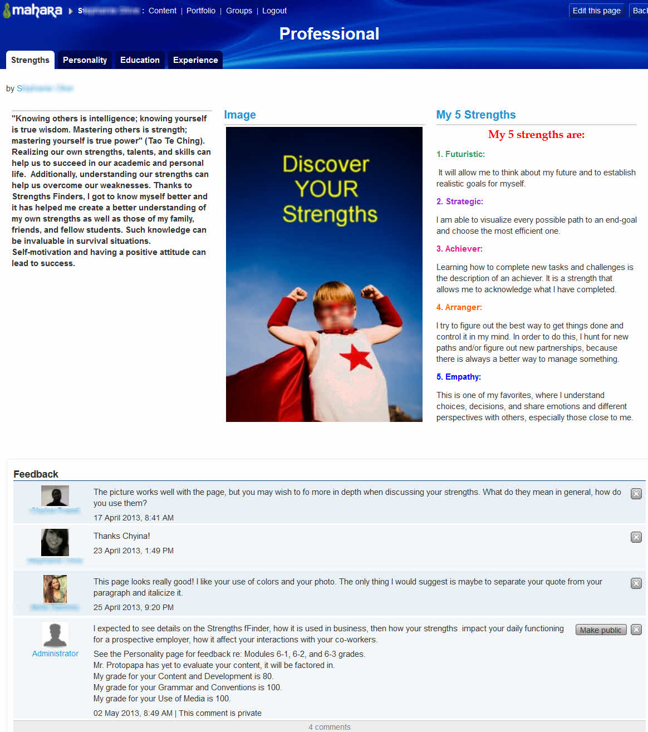

Slide 61


Slide 62
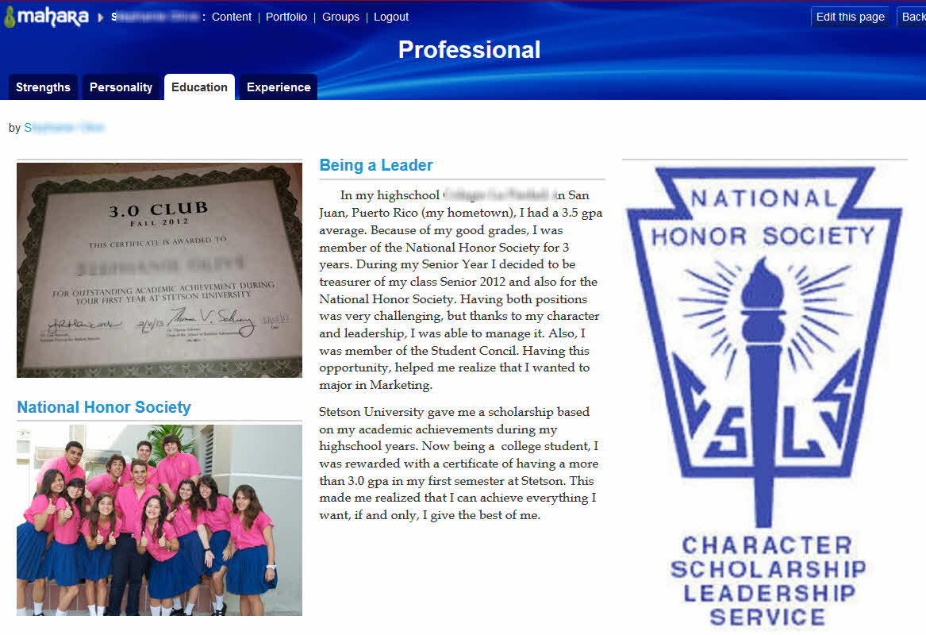

Slide 63
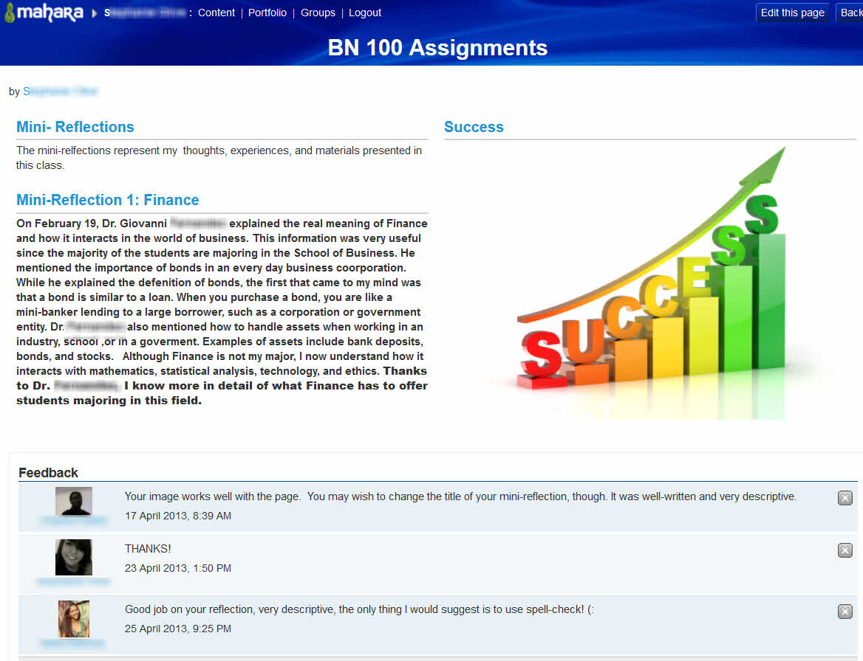

Slide 64
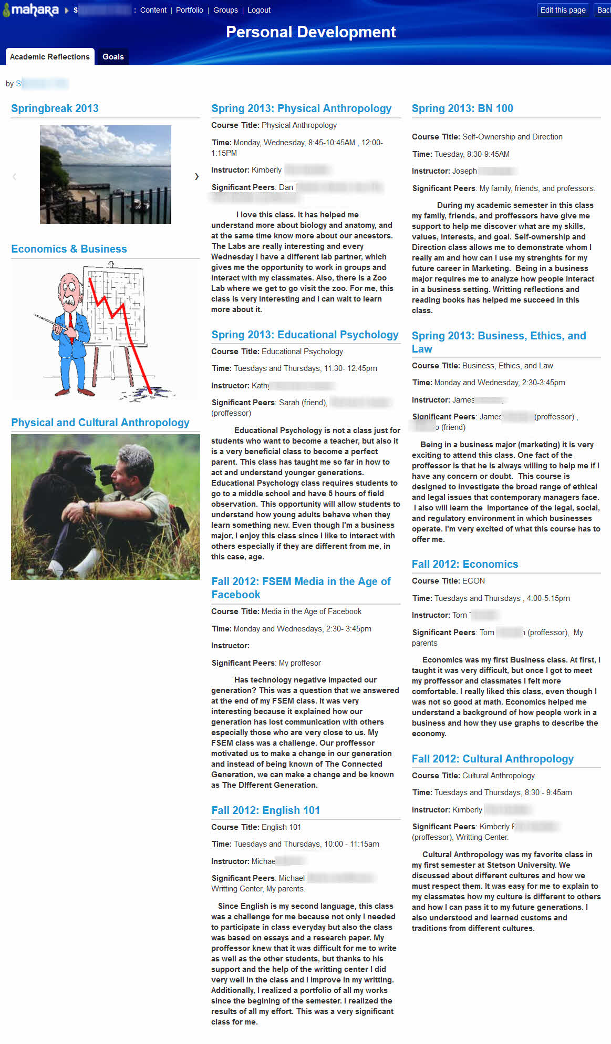

Slide 65
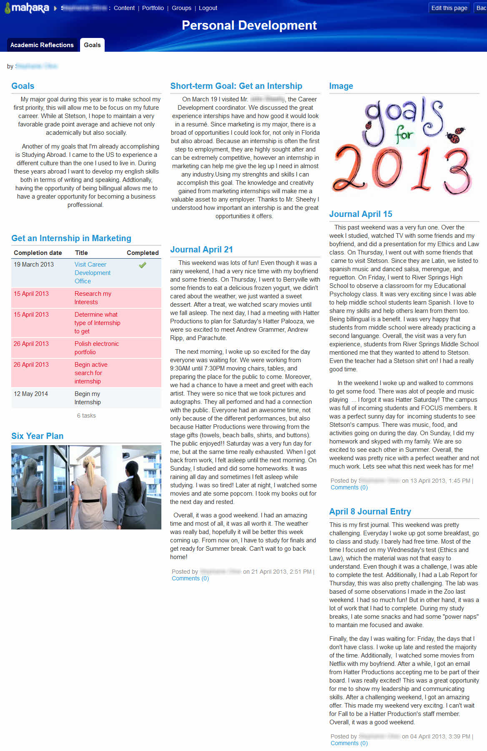

Slide 66


Slide 69
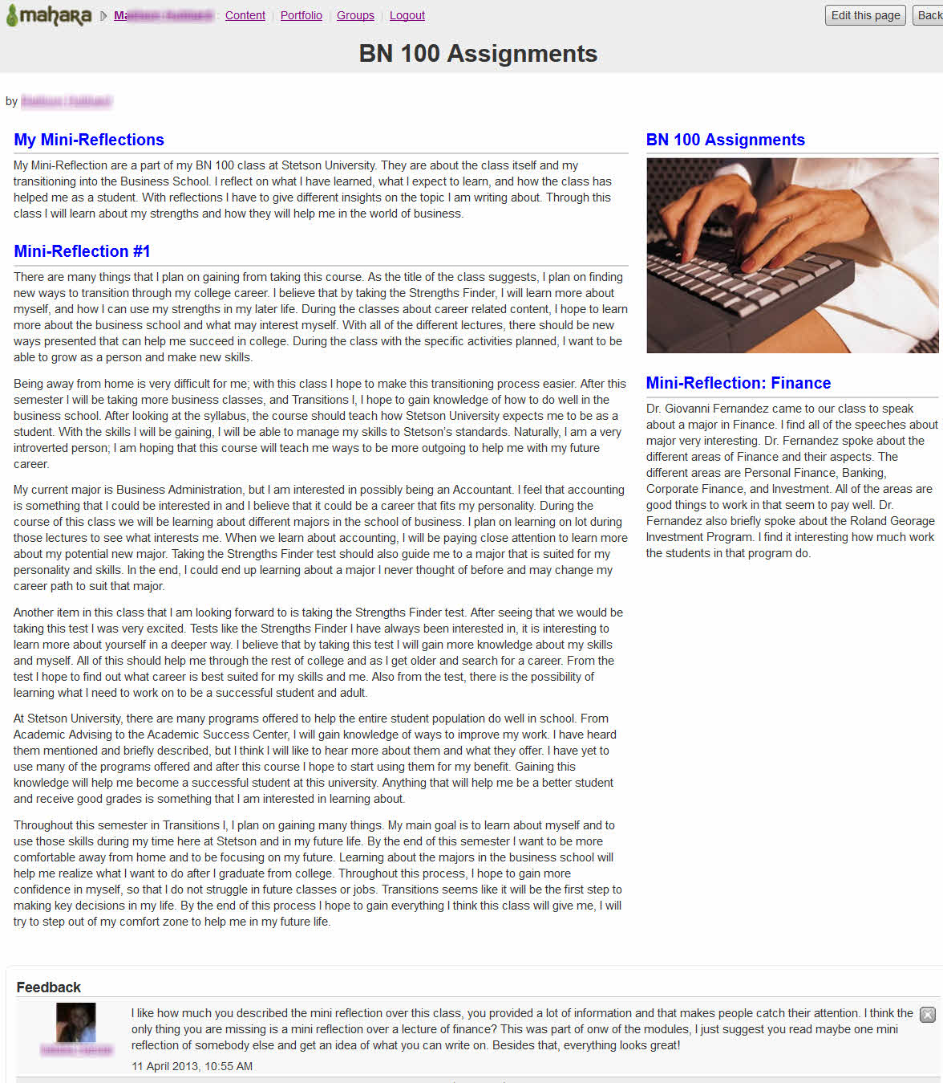

Slide 71
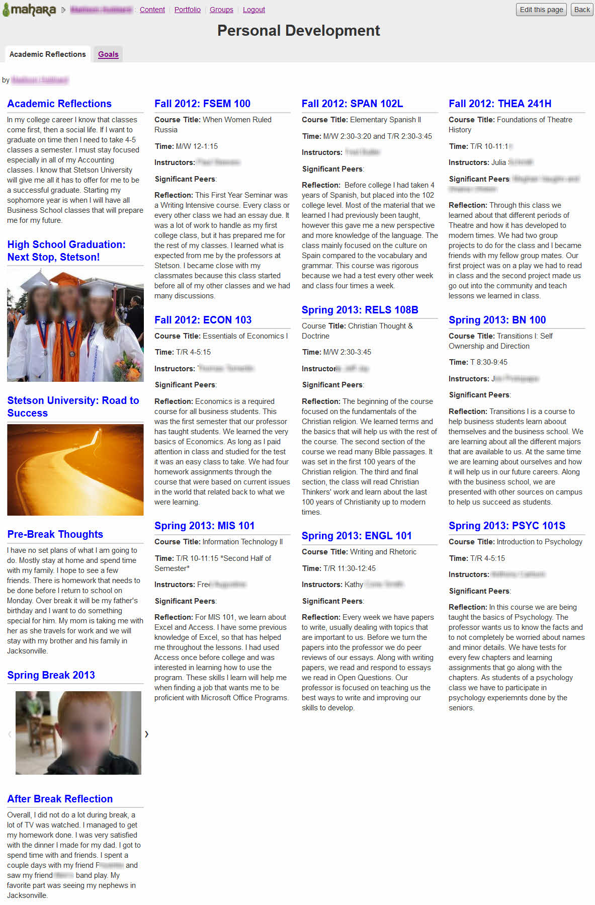

Slide 72
